Slide 1

Marketing Strategy

Slide 2

Agenda & Purpose
Purpose:
  Present the strategy & focus areas for CrossCap for the next year
  Review the “why” behind the recommendations
Agenda:
  Marketing Goals Review
  Marketing Strategy Overview
  Marketing Strategy Detail
  Proposed Action Plan
  Next Steps

Slide 3



Marketing Strategy - Stages
1. Marketing Strategy:
Outlines the overall marketing direction for the company & products based on client insights, competitor reviews & research, including:
Client personas and customer journey
Foundational changes or additions (branding, positioning, content, website, funnels, etc.)
Recommended marketing activities (lead generation, awareness, customer retention)
2. Marketing Foundation Implementation:
Based on the Marketing Strategy, make key foundational changes to:
Messaging, branding, positioning across all assets (website, social, print, etc.)
Content & structure changes to website & all assets (create new marketing materials, etc.)
Set-up any lead nurturing/marketing funnels & conversion packages
Essential prior to marketing outreach. All marketing drives back to this foundation. Skipping this step risks conversions, wastes time & money.
KPIs based initially on activity completed, ongoing based on increased lead captures & conversions
3. Marketing Activity Execution:
Marketing activities to generate leads & awareness (push & pull). All drive back to the Foundation set-up:
Lead generation activities, including advertising, direct marketing, events, association marketing, SEO
Awareness activities, including brand advertising, events, media relations, online listings, social media, content marketing
Relationship building & direct sales
KPIs for lead generation based on clicks & conversions, KPIs for awareness measured through new mentions, increased social followers, surveys.

Slide 4
Marketing Strategy
Goals

Slide 5
marketing foundation - messaging, positioning & branding
Goal: Convert more leads by updating messaging, positioning and branding
  Challenge: Prospects who land on the website or social media pages, or view any marketing outreach may not be converting to leads or demo requests because the current messaging & branding:
    Does not immediately position CrossCap’s products as enterprise level
    May actually indicate CrossCap is for smaller organizations or solopreneurs
  Goal: Clearly indicate to enterprise level prospects that they are in the right place when they land on the CrossCap website or view CrossCap anywhere online or in person/Position the company as the enterprise choice and invaluable software for the CMO/their team
  Action Steps: New messaging guide, updated messaging, branding and photos on the website and in key online and foundational marketing assets.

Slide 6
marketing foundation - messaging, positioning & branding
Goal: Convert more leads by clarifying CrossCap products & product hierarchy
  Challenge: When landing on the website, prospects may not be able to quickly understand which products are for them; may not be directed to the products we want them to focus on
  Goal: Make it clear that Marketing Calendar and Distro are the two main products, and clearly define them and direct ideal prospects to the one that’s right for them.
  Action Steps:
    Update product flow and positioning on the website

Slide 7
marketing foundation - website, core content & funnels
Goal: Convert more website traffic into marketing qualified leads
  Challenge: There is no immediately obvious and clear way to capture initial leads on the website for prospects who are not yet ready to book a demo.
  Goal: Get more website visitors to take an initial action to learn more and get on the email list (leading into the funnel)
  Action Steps: Add clear lower funnel calls-to-action on the home page and main product pages.

Slide 8
marketing foundation - website, core content & funnels
Goal: Convert more website traffic to sales qualified leads (demo requests)
  Challenge: There is no clear book-a-demo call to action on the home page or main product pages, and limited information on the book-a-demo pop-up.
  Goal: Get more website traffic to book demos from the website.
  Action Steps: Add a more obvious book-a-demo CTA on the main product pages and home page, create a robust book-a-demo page

Slide 9
marketing foundation - website, core content & funnels
Goal: Convert more marketing qualified leads to sales qualified leads
  Challenge: There is currently no process for moving initial marketing qualified leads (fill out a website form to download an ebook or similar) to a sales qualified lead (requests a demo)
  Goal: Convert more marketing qualified leads to sales qualified leads
  Action Steps:
    Create new lead nurture sequences for both product lines
    Update the website navigation, flow and content to reflect the ideal customer journey
    Create a B2B marketing kit for both product lines
    Create procurement/sourcing materials

Slide 10
marketing awareness
Goal: Increase awareness of CrossCap
  Challenge: There is a general lack of awareness of CrossCap and their products with ideal clients for both Marketing Calendar & Distro - including personas in procurement, marketing operations, senior leadership, and CMOs
  Goals: Increase awareness of CrossCap and their main products with all personas.
  Action Steps:
    Media Relations
    Analyst Relations
    Influencer Relations
    Sourcing team supplier lists
*also lead generation activities

Slide 11
marketing lead generation (inbound)
Goal: Increase new visitor website traffic
  Challenge: CrossCap is currently averaging 18.36 non-direct visitors per day (15.2 organic visitors per day, 2.76 referral visitors per day, and .4 social media referrals per day).
  Goals: Get more ideal client traffic to the CrossCap website
  Action Steps:
    Increase inbound marketing traffic to the website through SEO, hub pages, content marketing, Google Ads and social ads
    Increase the number of sites referring traffic back to the CrossCap website, including software review sites
      Encourage more customers to leave reviews

Slide 12
marketing lead generation (outbound)
Goal: Increase leads through targeted campaigns
  Challenge: Mosts of CrossCaps leads are currently generated through direct sales efforts, some SEO website traffic, and some referrals. More marketing qualified leads are required.
  Goals: Generate more marketing qualified leads through targeted campaigns
  Action Steps:
    Direct response social & search advertising (LinkedIn, Facebook/Instagram/Google)
    Direct response association/event marketing
    Direct account marketing-sales campaign

Slide 13
Marketing Strategy
Overview

Slide 14
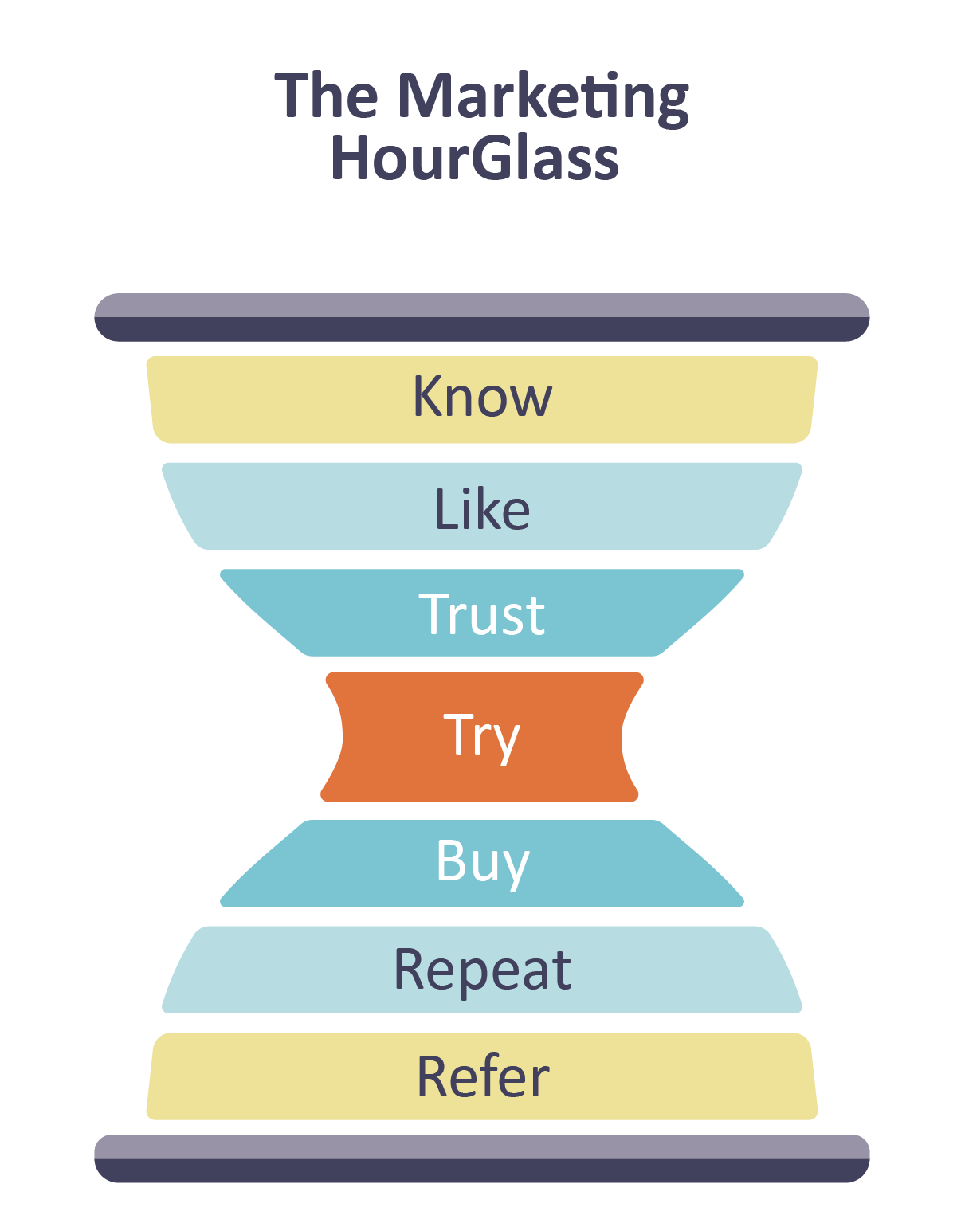
Marketing Strategy Overview Customer Journey

Slide 15
Marketing Hourglass Review
Know | Like | Trust | Try | Buy | Repeat | Refer
All awareness, lead generation, SEO, and outreach activities | Messaging, positioning, branding, people, mission, videos | Case studies, testimonials, examples, results, people, credentials, customer list, review sites | Videos, video demos, PDFs, eBooks, white papers, speaking, workshops, live demo | Live demo, sales process, implementation, training | Client retention, up-sells, repeat buys, engagement Ongoing customer care & support | Great experience, get what they expected, referral program
Currently only direct outreach - lack of awareness Biggest gap - Big opportunity | Messaging & positioning gap Another big opportunity | Customer logos on website, some testimonials Need more here - case studies, reviews, review site listings | Currently have some PDfs and live demos Opportunity to do more, in a strategic way | Currently doing this well Client interviews suggest some areas for improvement on implementation | Currently doing this well Client interviews suggest issues with some accounts. Make sure clients are aware of all relevant products | Currently providing a great experience to most clients Opportunity to do more strategic referrals

Slide 16
Marketing Strategy - Overview Summary
1. Marketing Foundation: Messaging & Positioning:
  Define the personas for the Marketing Calendar & Distro product lines
  Outline the customer journey for each product line
  Adjust messaging, images & branding to better target a larger corporate enterprise audience
  Update product positioning to highlight Marketing Calendar & Distro as the main product lines & adjust naming to reflect an enterprise level product
  Update existing website, social media & all online assets to match new branding, corporate/product positioning & messaging
2. Marketing Foundation: Website, Core Content, & Funnels:
  Recommend a new website flow and navigation to move ideal clients to the right product lines for them & match the customer journey
  Create a content marketing calendar & begin regular content creation
  Conduct keyword research, update website for SEO, and create HubPages
  Create new marketing funnels for Marketing Calendar & Distro
  Create B2B marketing kits for Marketing Calendar & Distro
  Create materials for Sourcing/IT
3. Marketing Awareness:
  Get on sourcing team preferred supplier lists
  Media/analyst/influencer relations - identify key media & influencers and pitch
4. Marketing Lead Generation (inbound):
  Update online review sites, claim new listings:
    Campaign to get clients to add reviews
  Increase content sharing on social:
    SME blog posts, consider YouTube video series & whitepapers - LinkedIn focus (articles, etc.)
5. Marketing Lead Generation (outbound):
  Search & Social Advertising
  Events & associations: Partner, attend, advertise, sponsor - lead back into funnels.
  Direct account targeting: Marketing-sales campaign

Slide 17

Marketing Strategy Overview
Marketing Foundation
Enterprise Level
Messaging & Branding
Website & Online Assets
Personas
Foundation Content
Awareness Campaigns:
Media/Influencer/Analyst Relations
Watch Demo Video
New Persona Lead Nurture Funnels
> Marketing Calendar
> Distro
Lead Nurture Sequence
for each persona
Lead Generation (inbound)
Content Marketing
SEO/Hub Pages
Online Listings/Review Sites
Book a Demo
Newsletter
Lead Generation (outbound)
Social/Google Ads
Events/Associations
Account Based Campaigns
Re-Engagement

Slide 18
Marketing Foundation
Actions

Slide 19
Marketing Foundation Goals
  Convert more prospects to marketing qualified leads by:
    Updating messaging, positioning & branding
    Clarifying CrossCap products and product hierarchy
  Convert more website traffic into marketing qualified leads and sales qualified leads
  Convert more marketing qualified leads to sales qualified leads
Action Steps:
Personas & Customer Journey
Messaging/Positioning/Branding
Website flow
New Marketing Funnels
B2B Marketing Kits

Slide 20
marketing foundation
section 1: marketing foundation
Action Step 1:
Personas & Customer Journey

Slide 21
marketing foundation - personas
Personas
Create detailed personas for the Marketing Calendar and Distro Products:
  Marketing Calendar:
    Marketing Operations Manager
    VP of Marketing/Director of Marketing (primary)
    CMO
    Sourcing
  Distro:
    Marketing Operations Manager
    VP of Marketing/Director of Marketing (primary)
    CMO
    Sourcing
Insights:
Clear marketing personas will support the creation of messaging, marketing materials, and targeting options.

Slide 22
marketing foundation - personas
Example: Marketing Calendar Personas
Ideal Target Organization
Enterprise level company (ideally $1B revenue plus)
Complex marketing organization
Multiple locations, branches or divisions
Has a head office with a corporate marketing department along with multiple independent marketing teams underneath
Head office has a need to know what’s going on across the organization, manages the plan company wide, manages the budget, reports on results, monitors regional marketing activities, or manages resources.

Slide 23
marketing foundation - personas
Example: Marketing Calendar Personas
Personas - Marketing Calendar:
CMO
Final budget approval
Not involved in evaluation or search
VP/ Director of
Marketing
Sourcing/ Procurement
Sourcing may initiate search or start with Marketing Ops recommendation
Search
Recommend
Evaluate
Initial approval Communicate with Sourcing
Marketing Operations
IT
IT involved to evaluate/confirm data security

Slide 24
marketing foundation - personas
Example: Marketing Calendar Personas
Persona 1: Marketing Operations Manager
Main user of the product at head office or oversees the person/team using the product
Highly influential in recommending and influencing the buying decision
VP of Marketing relies on this position for advice on product effectiveness
Title could be Marketing Operations Manager, Marketing Operations Specialist, Assistant to the CMO
Could be younger and tech savvy
Persona 2: Director of Marketing
or VP of Marketing
Title could be Director of Marketing, VP of Marketing, Marketing Manager
Reports to the CMO or highest marketing position
Main decision maker
Directly manages the person or team responsible for the product
Responsible for head office or corporate marketing - and dissemination of corporate marketing to regions, branches or locations
Responsible for monitoring KPIs, results reporting
Directly aware of the pain/issues of the marketing operations persona

Slide 25
marketing foundation - personas
Example: Marketing Calendar Personas
Persona 3: CMO
Highest marketing position in the organization
Title could be CMO or VP of Marketing
Ultimate final buying decision maker
Signs off on budget, but relies on recommendation of VP and Marketing Operations
Does not use the product
Is aware the product exists
Persona 4: Sourcing/Procurement Manager/IT
Responsible for keeping a list of approved vendors; identifying and approving vendors
Receives requests from divisions to find and recommend software solutions
Receives requests from divisions to evaluate software they’ve selected or to check for other options
Concerned about finding the right option for the organization, meeting technology and security standards, integrating with existing systems

Slide 26
marketing foundation - personas
Example: Distro Personas
Ideal Target Organization
Enterprise level company (ideally $1B revenue plus)
Has multiple customer-facing locations that require in-store signage
Primarily retail, could also be financial services, hospitality, or similar
Complex marketing organization
Has a head office with a corporate marketing operations department ultimately responsible for signage changes organization wide

Slide 27
marketing foundation - personas
Example: Distro Personas
Personas - Distro:
CMO
CCM
Final budget approval
Not involved in evaluation or search
VP/ Director of
Marketing
Sourcing/ Procurement
Sourcing may initiate search or start with Marketing Ops recommendation
VP/ Director of
Merchandising
Search
Recommend
Evaluate
Initial approval Communicate with Sourcing
IT
IT involved to evaluate/confirm data security
Marketing Operations
Merchandising Operations

Slide 28
marketing foundation - personas
Example: Distro Personas
Persona 1: Marketing Operations Manager
Main user of the product at head office or manages a regional area - or oversees the person/team using the product
Highly influential in recommending and influencing the buying decision
VP of Marketing relies on this position for advice on product effectiveness
Title could be Marketing Operations Manager, Marketing Operations Specialist, Merchandising Manager
Experiences the most pain
Persona 2: Director of Marketing
or VP of Marketing
Title could be Director of Marketing, VP of Marketing Operations, Marketing Manager or VP of Merchandising
Reports to the CMO or highest marketing position
Main decision maker
Directly manages the person or team responsible for the product
Ultimately responsible in store signage delivery/any mistakes or problems
Responsible for monitoring KPIs, results reporting
Directly aware of the pain/issues of the marketing operations persona

Slide 29
marketing foundation - personas
Example: Distro Personas
Persona 3: CMO
Highest marketing position in the organization
Title could be CMO or VP of Marketing
Ultimate final buying decision maker
Signs off on budget, but relies on recommendation of VP and Marketing Operations
Does not use the product
Is aware the product exists
Persona 4: Sourcing/Procurement Manager/IT
Responsible for keeping a list of approved vendors; identifying and approving vendors
Receives requests from divisions to find and recommend software solutions
Receives requests from divisions to evaluate software they’ve selected or to check for other options
Concerned about finding the right option for the organization, meeting technology and security standards, integrating with existing systems

Slide 30
Customer Journey Example: Marketing Calendar
 | Awareness |  | Consideration |  | Decision
 | Awareness | Lead Generation | Lead Conversion |  |  | Sales
 | Pre-Know | Know | Like | Trust | Try | Buy
Doing (Marketing Operations/ VP Persona) | Using Excel or PM software to manage marketing planning & calendars - Don’t know that Enterprise Marketing Calendars exist or what they are | Aware that Enterprise Marketing Calendars/CrossCap’s products exist | Researching CrossCap’s Marketing Calendar, figuring out what it is and what it does, exploring other options | Researching whether CrossCap’s marketing calendar will work for them - bring in other people and sourcing/IT | Trying out CrossCap to decide if it will work for their organization - may be demo-ing other products - IT & Sourcing is evaluating | Creating a statement of work/needs requirement, RFP, determining budget, getting real costs
CrossCap Information Needed | Need to know what they don’t know: > There’s a better way - Using Excel is risky & inefficient > Enterprise marketing calendars exist & enterprises need them -They are different from other calendars - What a marketing calendar can do that you don’t know | Need to know the details of what an Enterprise Marketing Calendar is, how it’s better/ different from Excel/ PM calendars, the problems it can solve - and what this can do for their marketing (benefits) | Need to know that CrossCap works with other companies like them - enterprise level - how implementation and support are, what the experience is like. | Need to know that other companies like them have had great experience with CrossCap - that CrossCap has delivered on what it promised | Need to know that CrossCap will work for them and and their unique marketing processes - or that CrossCap can make it work. Need to get a feel for what it would be like to work with CrossCap | Need to make sure that what CrossCap is proposing will get through their gatekeepers so they can purchase.
Specific Materials | Blog posts, Social Media, eBooks, Whitepapers, Videos |  | Email Nurture, Product brochure, Reports, Product Comparison Guides, Service & Implementation Sheets, Case Studies, Testimonials, Personality & Brand |  | Video demos, Data sheets, Technical specs, support & implementation information, Analyst reports, FAQ, Consultations, Pricing info, Proposal

Slide 31
Customer Journey Example: Distro
 | Awareness |  | Consideration |  | Decision
 | Awareness | Lead Generation | Lead Conversion |  |  | Sales
 | Pre-Know | Know | Like | Trust | Try | Buy
Doing (Marketing Operations/ VP Persona) | Using Excel or PM software to manage store profiling - aware that other solutions exist - but not a good one - usually through their printer or graphics firm | Aware that Distro and similar products exist | Researching CrossCap’s Distro, figuring out what it is and what it does, exploring other options | Researching whether CrossCap’s Distro will work for them - bring in other people and sourcing/IT | Trying out CrossCap to decide if it will work for their organization - may be demo-ing other products - IT & Sourcing is evaluating | Creating a statement of work/needs requirement, RFP, determining budget, getting real costs
CrossCap Information Needed | Need to know what they don’t know: > There’s a better way - Using Excel is risky & inefficient > Store profiling software exists & retailer need it - Different from what printers offer | Need to know the details of what an Store Profiling software is, how it’s better/ different from Excel/printer options, the problems it can solve - and what this can do for them (benefits) | Need to know that CrossCap works with other companies like them - enterprise level - how implementation and support are, what the experience is like. | Need to know that other companies like them have had great experience with CrossCap - that CrossCap has delivered on what it promised | Need to know that CrossCap will work for them and and their unique marketing processes - or that CrossCap can make it work. Need to get a feel for what it would be like to work with CrossCap | Need to make sure that what CrossCap is proposing will get through their gatekeepers so they can purchase.
Specific Materials | Blog posts, Social Media, eBooks, Whitepapers, Videos, Podcasts |  | Email Nurture, Product brochure, Reports, Product Comparison Guides, Service & Implementation Sheets, Case Studies, Testimonials, Personality & Brand |  | Video demos, Data sheets, Technical specs, support & implementation information, Analyst reports, FAQ, Consultations, Pricing info, Proposal

Slide 32
marketing foundation
section 1: marketing foundation
Action Step 2:
Messaging, Positioning & Branding

Slide 33
marketing foundation - messaging, positioning & branding
Messaging, Positioning & Branding Overview
Update corporate & product messaging, positioning and branding to make it clear who the products are for, what they do, and that they are for an enterprise level organization:
  Update branding & images for CrossCap overall
  Update messaging for:
    CrossCap corporate
    Distro
    Marketing Calendar
  Update product positioning for Distro & Marketing Calendar and make it clear which
Actions:
Updating corporate & product messaging, positioning & branding will let ideal enterprise clients know that they’re in the right place & increase conversions.

Slide 34
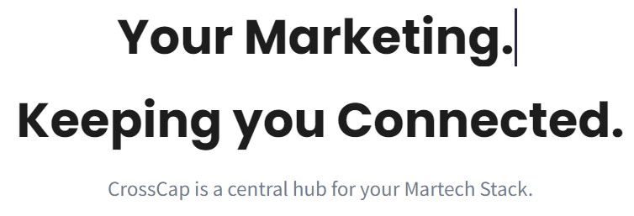
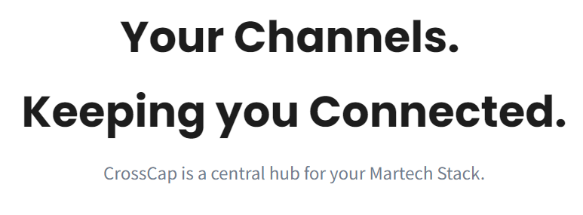
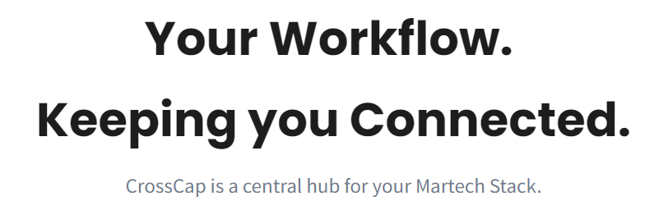
marketing foundation - messaging, positioning & branding
Example: Corporate Positioning
Messaging:
  Corporately, your current high level messaging is:
    “The Central Hub for your Martech Stack”
    “Your Marketing (Workflow/Channels) - Keeping You Connected”
  Nothing in the positioning speaks immediately to:
    True product benefits
    Your ideal type of client (only indication is client logos on website)
    Service, customization, implementation, etc. (key from client insights)
  Enterprise clients may not realize that what you have to offer is for them.

Slide 35

marketing foundation - messaging, positioning & branding
Example: Corporate Positioning
Messaging:
  Clearly position CrossCap corporately so ideal clients know right away that they are in the right place, and this is a company that can serve them:
    Enterprise marketing solutions company serving large, multi-location companies with complex marketing challenges
    Enterprise level implementation (customization/service/support)
Actions:
Make sure all client personas know right away that they’re in the right place & what Crosscap has to offer is for them.
Enterprise Marketing Management Solutions
We partner with large multi-location enterprises to solve their complex marketing planning, promotion & signage distribution challenges
World Class Enterprise SaaS Solutions | Custom Implementation | Strategic Consulting | Boutique Customer Support

Slide 36
marketing foundation - messaging, positioning & branding
Example: Core Difference - CrossCap
CrossCap develops enterprise marketing management software solutions for some of the world’s best companies.
We partner with large multi-location enterprises to solve their complex marketing planning, budgeting, promotion and retail store profiling requirements and provide enterprise level custom implementation services.
CrossCap - custom enterprise marketing management solutions
World Class Enterprise SaaS Solutions | Custom Implementation | Strategic Consulting | Dedicated Customer Support

Slide 37
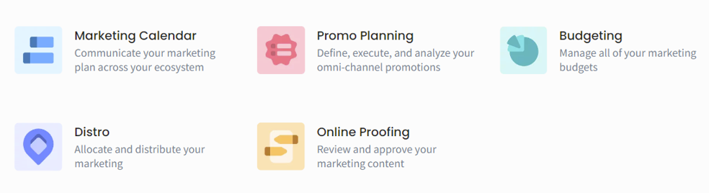
marketing foundation - messaging, positioning & branding
Example: Product Positioning
Product Structure:
  Products are currently positioned individually - not clear if the products work together or are all stand-alone:
    Could give the perception that all products hold equal weight
    Up to the prospect to figure out if/how they work together/which product they need now/first
Insights:
CrossCap needs to take the lead in moving prospects to the right products.

Slide 38
marketing foundation - messaging, positioning & branding
Example: Product Positioning
Product Structure:
  Re-evaluate overall product positioning:
    Two main product lines: Marketing Calendar and Distro?
      Position other product lines as add-ons underneath (can still be sold stand-alone if needed?)
      Make it clear which companies need which product lines when - move them in the direction WE want them to take

Slide 39
marketing foundation - messaging, positioning & branding
Example: Product Positioning
Product Naming & Description:
  High level product messaging does not clearly state what the product does, or indicate a clear target market (does not talk about whether the products are ideal for a certain industry, size of company, type of company, or position within the company)
    Prospect has to figure out if the product is suited for them - could accidentally opt themselves out.

Slide 40

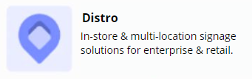
marketing foundation - messaging, positioning & branding
Example: Product Positioning
Product Naming & Description:
  Clearly position both products for:
    Size of company: Enterprise solutions for complex marketing environments
    Vertical Market:
      Marketing Calendar - no vertical market differentiation initially (future possibility)
      Distro - start with a Retail vertical
        Future: more verticals (financial services, etc.)
        Future: sub-verticals (grocery, clothing, electronics, etc.)

Slide 41
marketing foundation - messaging, positioning & branding
Example: Core Difference - Marketing Calendar
CrossCap Enterprise Marketing Calendar is an organization-wide calendar & planning system specifically designed for complex multi-region, multi-country and multi-location enterprises who run complex campaigns simultaneously.
CrossCap Enterprise Marketing Calendar ensures executive-level visibility and insights to past, present and future global campaigns while being powerful enough for marketing ops to plan and execute specific local-market promotions.
CrossCap Enterprise Marketing Calendar - an enterprise calendar, planning and implementation system CMOs love and marketing ops actually use

Slide 42
marketing foundation - messaging, positioning & branding
Example: Core Difference - Distro
CrossCap Distro is a customizable store-profiling & in-store signage distribution software system for national and global retail, branch and multi-location enterprises.
CrossCap Distro - store-profiling system customized for customer-facing multi-location enterprises

Slide 43
Example: Core Difference
  CrossCap has a unique position in the marketplace right now with no real true competitors at the enterprise level (but perception and awareness are reality)
  Our client interviews indicate that what CrossCap’s ideal customers value most are:
      Flexible and customizable implementation to match how they work best
      The real ability to handle an enterprise level implementation but with the nimbleness and responsiveness of a smaller company
      Responsiveness, “smarts”, ability to quickly make fixes, figure out solutions, guide the conversation, enhancements
      True partner - they feel CrossCap really cares, and believe they are with them to support their future
Insights:
No one else is really doing with CrossCap is doing
Opportunity to really own these categories with more awareness
Need to be clear on the Enterprise level position
True differentiation is in partnership, implementation, innovation, customer care

Slide 44
marketing foundation - messaging, positioning & branding
Example: Core Difference
Opportunity to really differentiate CrossCap in two key areas:
  While all the competitors lead with messaging around type of software, features, and technical benefits… CrossCap can stand out by focusing on the ability to provide an enterprise level implementation but with the innovation, customization, partnership and boutique one-to-one customer care of a smaller, more nimble firm.
    Small firms promise everything and can’t fulfill - the Oracles of the world make you fit yourself in their software box
  While all the competitors target all sizes of companies… CrossCap can design everything they do around supporting Enterprise level organizations

Slide 45
Corporate Branding
Branding/Images:
  Choose images that clearly position CrossCap as serving enterprise level clients
  Stay away from images that may indicate CrossCap services smaller companies or solopreneurs.
  Add some complementary colors to the branding palette that are bolder, reflect an enterprise feel, and can “pop” in ads/posts
Insights:
Opportunity to use branding and images to position CrossCap at the Enterprise level

Slide 46
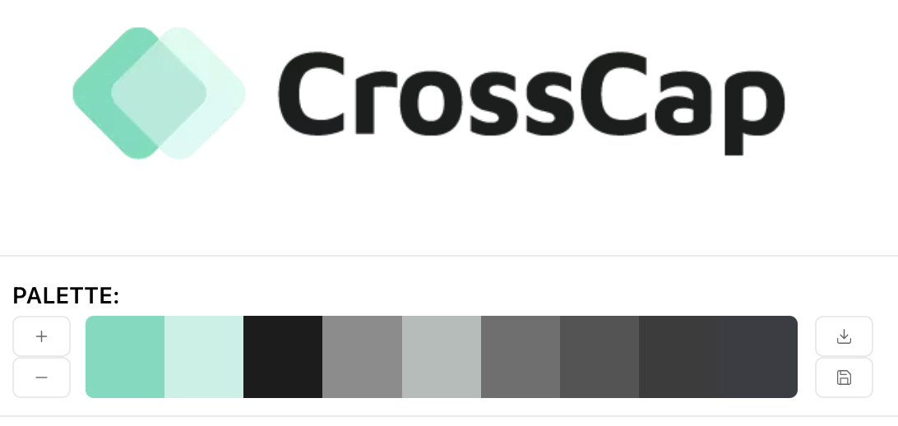

marketing foundation - messaging, positioning & branding
Update Images & Branding
Update images & branding to better reflect an Enterprise level company

Slide 47
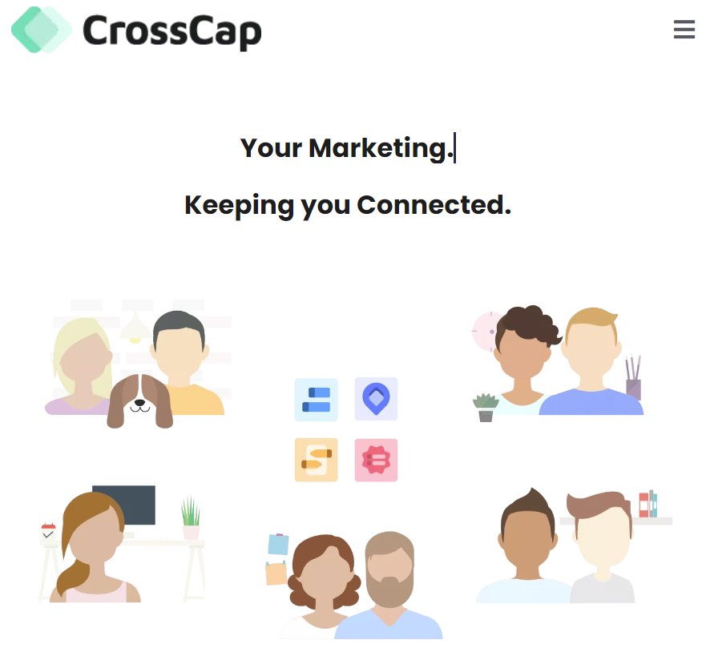
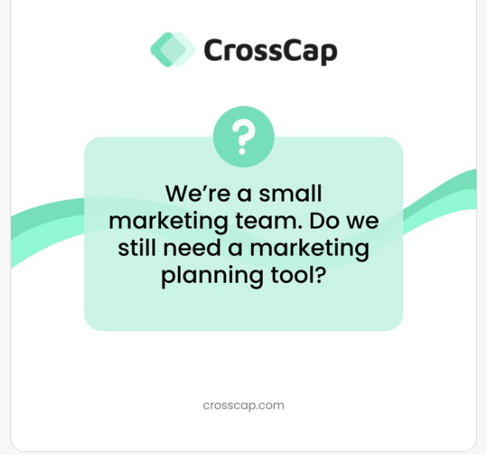
marketing foundation - messaging, positioning & branding
Corporate Branding
Branding/Images:
  Main images on website feature people & pets in everyday situations, some at home, some at work
    May give the perception that CrossCap’s products are for smaller companies/solopreneurs - not an “enterprise” feel
  Current brand colors are in the pastel range:
    The pastel colors don’t scream “enterprise” or pop for online/offline ads/posts

Slide 48
marketing foundation - messaging, positioning & branding
Update Images & Branding
Update Images & Branding to Reflect an Enterprise-level Company
  Recommend current teal colour + additional colours to give more depth to the logo and to the brand pallet. Either add in additional colours or move in a completely new direction with an entire brand revamp.
  Use of images is currently illustration - recommend moving to high-end photography (stock) that shows your ideal customer (CMO, Marketing Ops) and their ideal work situation (global, teams, in-store) so that it is very clear who CrossCap is for Adjust messaging for corporate and products:
Insights:
With the complexity CrossCap’s existing customers manage each day, it is key that potential customers see a company with products who can support their own global marketing complexity. Stronger imagery helps achieve this message.

Slide 49
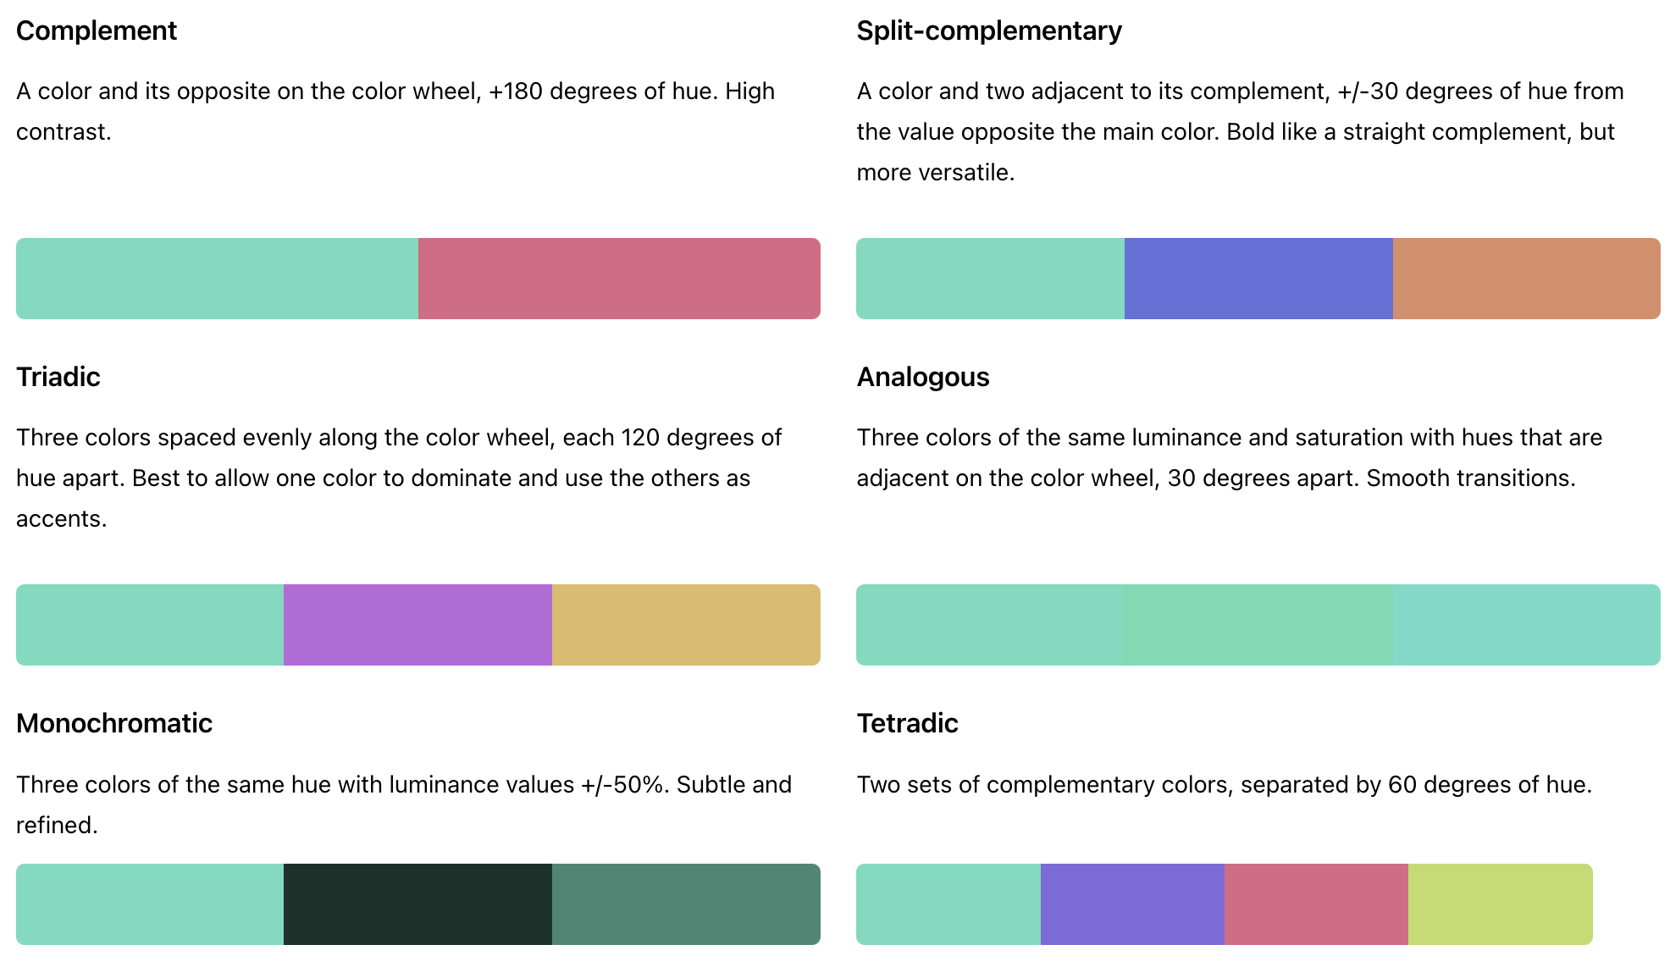
marketing foundation - messaging, positioning & branding
Brand Colors
Update images & branding to better reflect an Enterprise level company
Insights:
Options of you want to keep current teal colour and add in additional colours

Slide 50
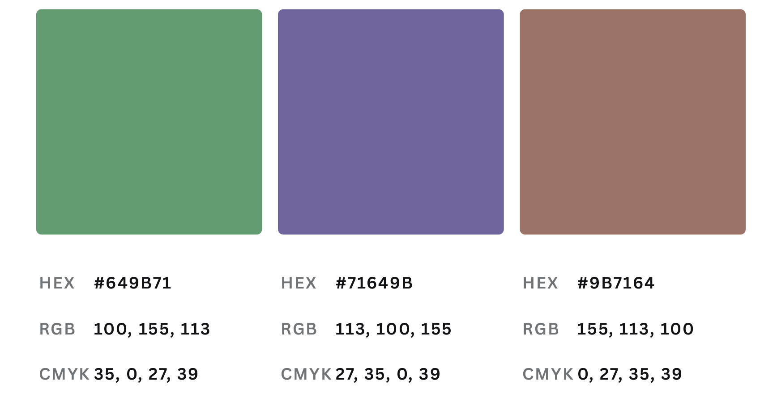
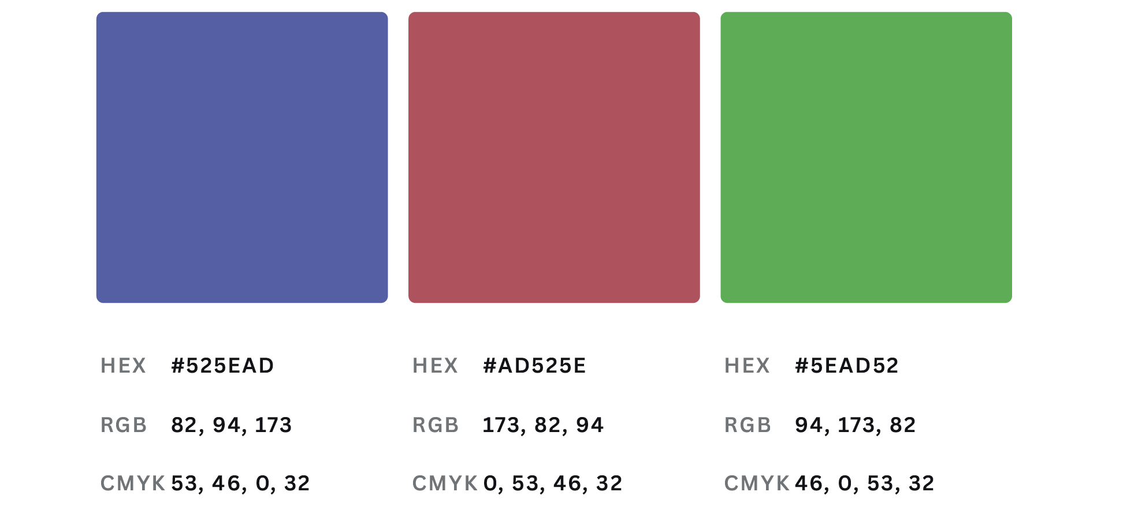
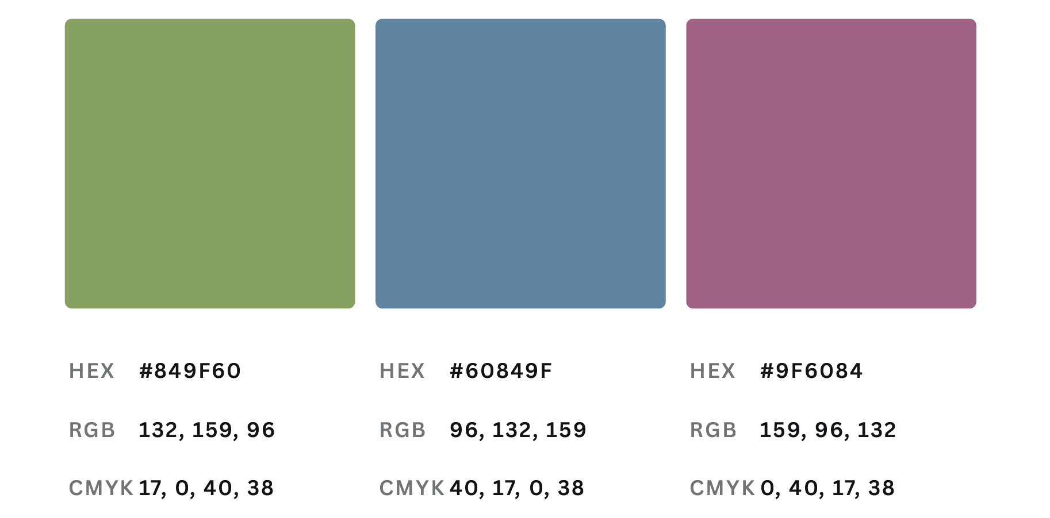
marketing foundation - messaging, positioning & branding
Branding Colors
Insights:
Options to depart to a more serious green or lead with blue - typical of Enterprise brand colours
Consider a full logo/colour palette redesign/refresh

Slide 51
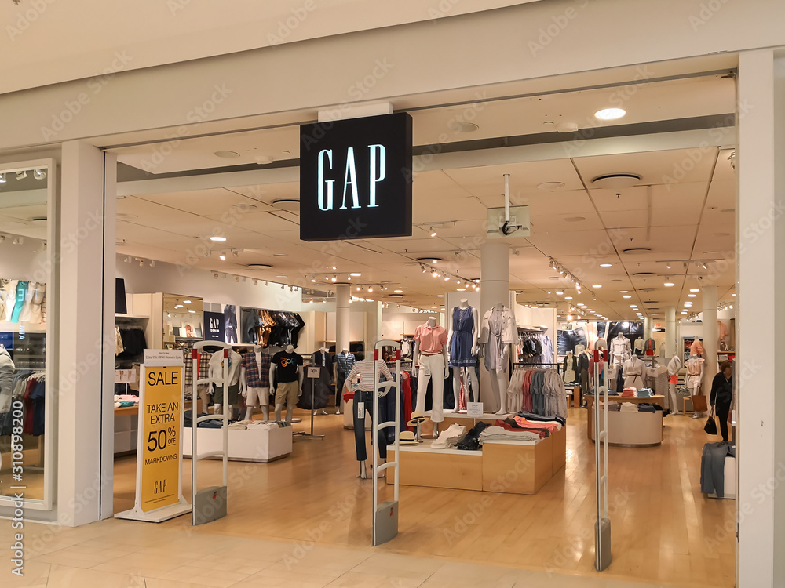




marketing foundation - messaging, positioning & branding
Distro
  Recommend considering imagery that reflects what problems Distro helps it solve

Slide 52



marketing foundation - messaging, positioning & branding
CMO
  Recommend showing images of the CMOs and executives
  who CrossCap wants to be invaluable to

Slide 53




marketing foundation - messaging, positioning & branding
Calendar
  Recommend considering imagery that reflects the global and enterprise nature of the products

Slide 54


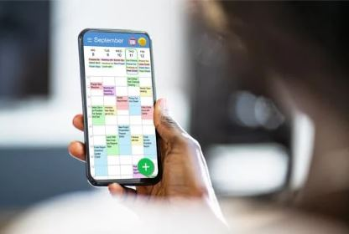

marketing foundation - messaging, positioning & branding
Calendar Product in Use
  Recommend taking some original imagery of the products in use, or as a secondary option, using photoshop.

Slide 55



marketing foundation - messaging, positioning & branding
Marketing Ops
  Recommend using high quality photography that represents the marketing ops professionals
  CrossCap serves

Slide 56

marketing foundation - messaging, positioning & branding
Imagery
Insights:
Move to photography so there is no confusion about who Cross Cap is for nor what you do.
Consider high-end stock photography, then graduate to 100% custom photography for the brand/company

Slide 57
marketing foundation
section 1: marketing foundation
Action Step 3:
New Website Flow

Slide 58
Key Insights: Website review
  Your website is:
    Your marketing hub that all marketing activities drive to
    Your inbound marketing hub that can help people find you
  Your website needs to:
    Immediately let your ideal clients know that they’re in the right place, and that what you have to offer is for them
    Move your clients in the direction you want them to take (direct them to the right product, get them on your lead nurture list)
    Enable your prospects to take themselves through their own customer journey
    Act as an entry point to continue marketing to them and supporting them through the customer journey
Actions:
Turn the website into a powerful tool to both attract and convert prospects.
Review and update to match branding, messaging, positioning, persona, content, funnel, flow & marketing recommendations.

Slide 59
Website New Navigation & Flow
CMO Marketing Ops Products Resources Company Contact
CMO
The Ultimate Guide to National & Global Marketing Planning and Promotion for Large Enterprise CMOs
The Ultimate CMO Guide to Multi-Location In-store, Branch and Franchisor Marketing for Large Enterprises
Marketing Ops
The Ultimate Guide to National & Global Marketing Planning and Promotion for Large Enterprise Marketing Operations
The Ultimate Guide to Large Enterprise Marketing Operations for Multi-Location In-store and branches
Products
Distro
Marketing Calendar
Budgeting
Promo Planning
Online Proofing
Resources
Blog
White papers
Case Studies
Newsletter
Ebooks
IT Kit
Sourcing Kit
Company
News
Events
Blog
Company Story
Team
Careers

Slide 60
marketing foundation
section 1: marketing foundation
Action Step 4:
New Website Funnels
& Lead Nurturing Sequences

Slide 61
Persona Funnels
Marketing Calendar Funnel: VP of Marketing & Marketing Operations Personas
  Main persona
  Main CTA on website
  Most lead generation activities will drive to this funnel
Funnel Includes:
  Main Landing Page, CTA, Thank You Page
  Auto Responder Email
  Four Email Nurture Sequence with CTA to Book a Demo
  Once Sequence is Complete - Move to Ongoing Newsletter
  Consider Monthly Re-Engagement Emails

Slide 62
Persona Funnels
Marketing Calendar: Marketing Operations Persona Funnel
Why you need to stop using Excel as your enterprise marketing calendar
eBook:
5 Reasons to STOP Using Excel
Inbound Marketing:
Content Marketing Social Media
SEO/Hub Pages
Website Landing Page/CTA:
Enterprise Marketing Calendar Software Buyer’s Guide
Ready?
Book a Demo
Get a single source of truth for your complex marketing organization
eBook/Use Case
10 (surprising) reasons you need an enterprise level marketing calendar now
eBook
Outbound Marketing
PPC & Social Ads
Events/Associations
Not Ready? Ongoing Newsletter
How Walmart streamlined their marketing with CrossCap’s Enterprise Marketing Calendar
Case Study
How a customized marketing calendar transforms your enterprise marketing (book demo now)
Video leading to Book a Demo

Slide 63
Persona Funnels
Distro: VP of Marketing/Marketing Operations Persona
  Main persona
  Main CTA on website
  Most lead generation activities will drive to this funnel
Funnel Includes:
  Main Landing Page, CTA, Thank You Page
  Auto Responder Email
  Four Email Nurture Sequence with CTA to Book a Demo
  Once Sequence is Complete - Move to Ongoing Newsletter
  Consider Monthly Re-Engagement Emails

Slide 64
Persona Funnels
Distro: Marketing Operations Persona Funnel
Why you need to stop using Excel to manage your retail in-store signage
eBook:
5 Reasons to STOP Using Excel
Inbound Marketing:
Content Marketing Social Media
SEO/Hub Pages
Website Landing Page/CTA:
Enterprise Store Profiling Software Buyer’s Guide
Ready?
Book a Demo
Centralize your retail store signage distribution
eBook/Use Case
10 (surprising) reasons you need an enterprise level store profiling software now
eBook
Outbound Marketing
PPC & Social Ads
Events/Associations
Not Ready? Ongoing Newsletter
How The Gap streamlined their in-store signage with CrossCap’s Distro Store Signage Software
Case Study
How a customized** transforms your enterprise marketing (book demo now)
Video leading to Book a Demo

Slide 65
marketing foundation
section 1: marketing foundation
Action Step 5:
B2B Marketing Kit

Slide 66
B2B Marketing Kit
B2B Marketing Content Kit
  Create the right content to help move ideal clients through each phase of the buyer journey
  Can use and repurpose this content in many ways:
    On the website (main content and/or PDF downloads)
    As downloads for lead nurturing sequences
    Email, advertising, and social media campaigns
    Inspiration or can be repurposed over and over for additional content for blog posts, webinars, podcasts, social media content, events, advertisements, etc.
    Conferences & trade shows
    The sales team

Slide 67
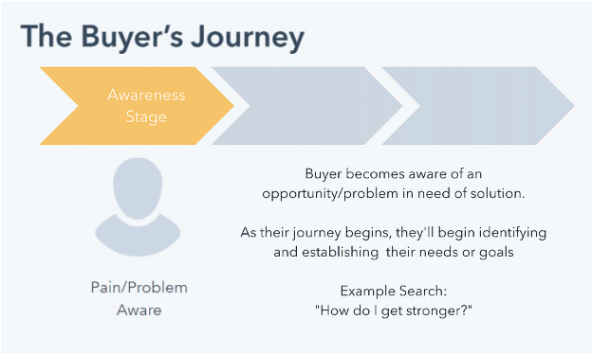
B2B Marketing Kit
B2B Marketing Content: Awareness Stage
Type of content:
Top level educational content to help solve a problem, get an answer or meet a need:
Blog Post
Social Media Post
Whitepaper
Checklist
How-To Video
Kit or Tool
Ebook or Tip Sheet
Educational Webinar
*image source: HubSpot

Slide 68
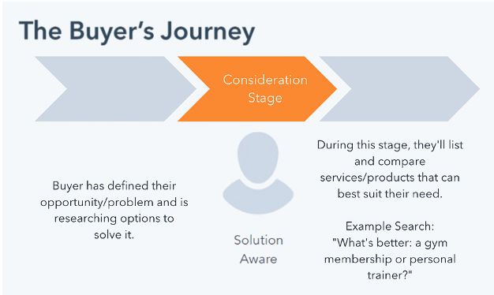
B2B Marketing Kit
B2B Marketing Content: Consideration Stage
Type of content:
They know they have a problem that has to be solved, and now they’re trying to discover the best solution. The need for a future purchase commitment creeps up as they’re evaluating their options:
Email nurturing sequence
Product comparison guide
Case study
Videos
Video demo
Original research & reports
Podcasts & webinars
*source: HubSpot

Slide 69
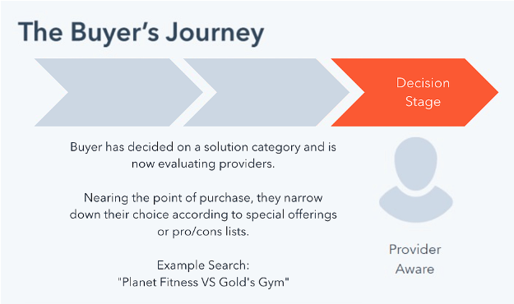
B2B Marketing Kit
B2B Marketing Content: Decision Stage
Type of content:
As prospects near the end of the buyer’s journey, they’re evaluating providers. Content should cover everything a prospect needs in order to make that purchase decision.
Product brochures, data sheets/technical spec sheets
Service/support/implementation sheets
Pricing info
FAQs
Analyst reports
Free trial/live demo
Consultation
*source: HubSpot

Slide 70
B2B Marketing Kit
B2B Marketing Kit Recommendation for CrossCap
  Create the following items for a B2B marketing kit and make them available for web, PDF, and print:
    Company Brochure/Product Catalog: An overview of all products, how they fit together, how they are used, along with key company information
  Marketing Calendar & Distro:
    Product Brochure for main marketing and awareness stage
    Implementation, Support & Service Sheet for main marketing and consideration stage
    Data/Spec Sheet for sourcing/IT/decision stage
    Testimonial sheet for main marketing and consideration stage
    Case studies for main marketing and consideration stage
    Main positioning white paper for awareness, consideration and lead nurturing campaigns

Slide 71
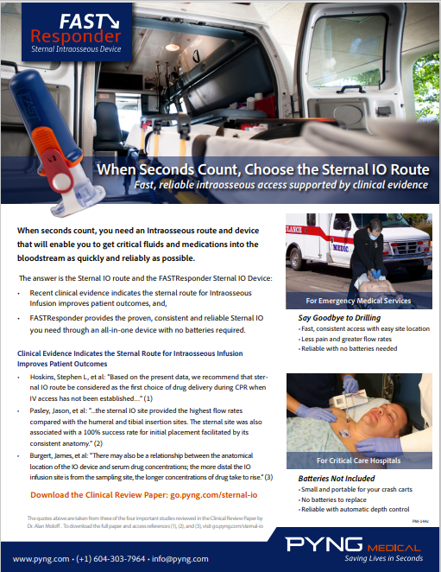

B2B Marketing Kit
B2B Marketing Kit Example - Product Sheet

Slide 72


B2B Marketing Kit
B2B Marketing Kit Example - Multiple Product Sheets

Slide 73
B2B Marketing Kit
B2B Marketing Kit Detail
  Company Brochure/Product Catalog: An overview of all products, how they fit together, how they are used, along with key company information
  Product Brochure: 2 to 4 pages giving a complete high level introduction to the product & company, including product features & benefits, company & longevity, implementation, support & services, reference clients, and testimonials
  Data/Sell Sheet: Quick product overview, easy reference, easy to use for RFPs and competitor comparisons
  Support & Service Sheet: 1 to 2 pages providing an overview of customization, implementation, support & service
  Testimonial Sheet: One sheet highlighting testimonials from your most ideal reference clients
  Case Studies: Consider individual case studies on the product (benefits & results), customization/implementation, service & support
  Use Cases: Similar to case studies, but use cases highlight specific applications of the product - could also be specific vertical applications
  Technical Specifications: Including everything a sourcing manager or IT department would need to know, including security & integrations
  White Papers: Connects your product to a specific trend, topic or technology; demonstrates your knowledge and authority in a certain area; an authoritative report on a topic that highlights a problem and positions your company as an expert on solving the problem

Slide 74
Section 2:
Marketing Awareness
Actions

Slide 75
awareness
Marketing Awareness Goals
  Challenge: There is a general lack of awareness of CrossCap and their products with ideal clients for both Marketing Calendar & Distro - including personas in procurement, marketing operations, senior leadership, and CMOs
  Goals: Increase awareness of CrossCap and their main products with all personas.
*Note: these supplement lead generation activities
Action Steps:
Media Relations
Analyst Relations
Influencer Relations
Sourcing team supplier lists

Slide 76
awareness
section 2: marketing awareness
Action Step 1: Media Relations

Slide 77
awareness - media relations
Awareness: Media Relations
Action Steps:
  Identify key media (news, trade, associations), including specific contacts & opportunities to submit press releases
  Post & share news releases through online news sites
  Create and share news releases to specific contacts and submission opportunities
  Newsworthy topics include:
    New technology or use cases
    New customers
    Awards
    Current topics angles
  Media relations can increase awareness of CrossCap and inform prospects of important events, milestones, and information.
  News releases can be posted online to increase awareness and SEO traffic back to the website
  News releases posted on the website can enhance credibility
  News releases picked up by the media (whether it’s mainstream, local or trade media) and republished has a strong credibility factor.

Slide 78
awareness - media relations
Media Relations Notes
  Consider a media relations approach - news releases mentioning enterprise level customers, directly target key tech & marketing media
  Understand that media coverage will need to be part of a consistent approach to developing relationships with the news media who cover your space.
  The purpose of having a News Release section on your website is to gather all the major company announcements in one place, to showcase your company’s accomplishments which don't always lend themselves to a blog post, to formalize the process, to show you are savvy enough to be ready to speak to the press and are doing things newsworthy
  You don’t have to publish your news releases to the wire
  Research publications/journalists who cover your space, develop a relationship with them, follow on social, feed them interesting insights from your co./industry consistently (monthly) to become a valued and reputable source
  Nurture the relationship, understand it is the long game and journalists get pitched every day for “free” promotion
Insights:
Media relations can be done in-house but will require a consistent and dedicated effort to both produce content and to develop the industry relationships
PR Firms are for hire for specific campaigns and will require significant lead time (4-6 months) to ramp up.

Slide 79
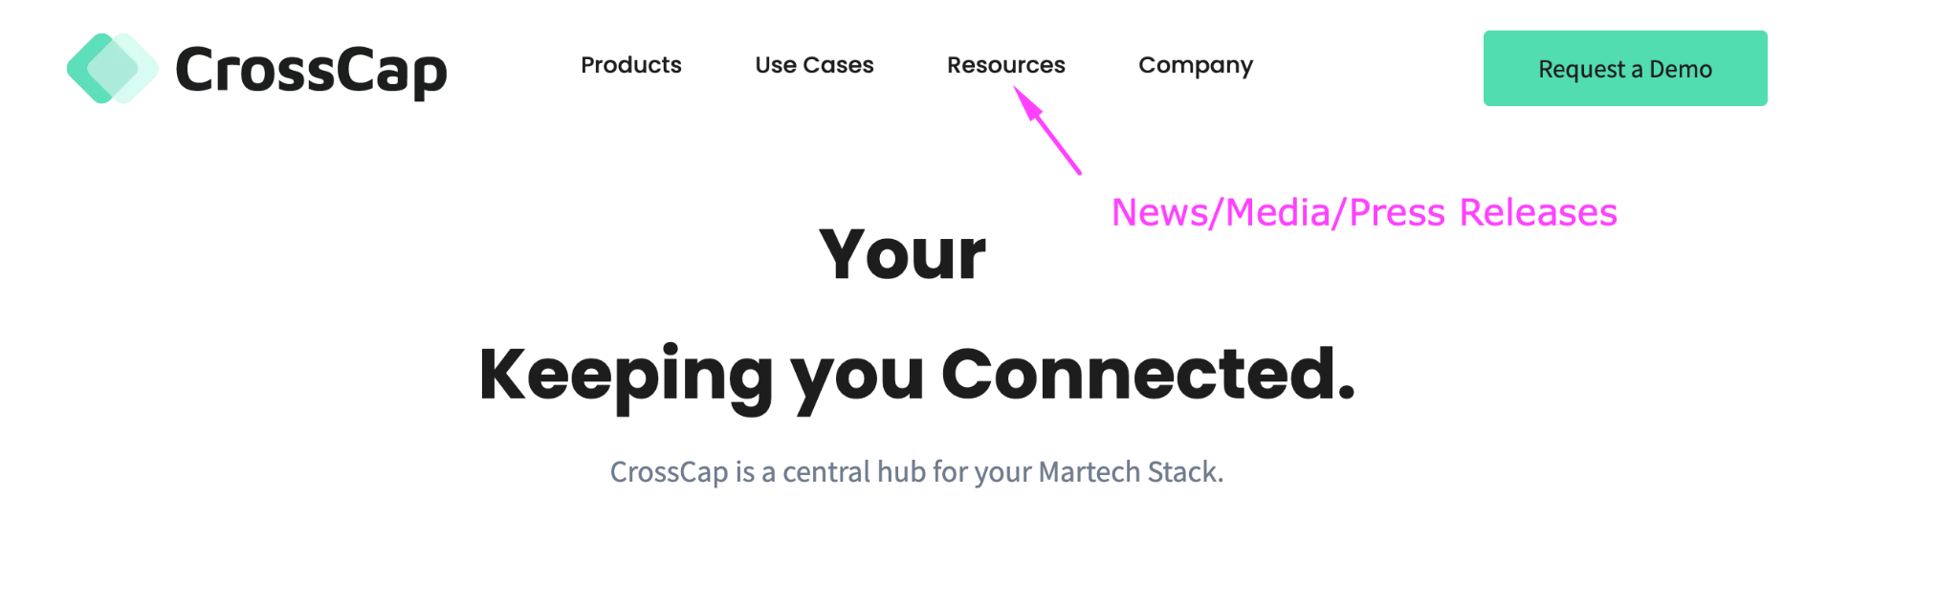
lead generation (inbound) - content marketing & social media
Add Media Section to Website

Slide 80
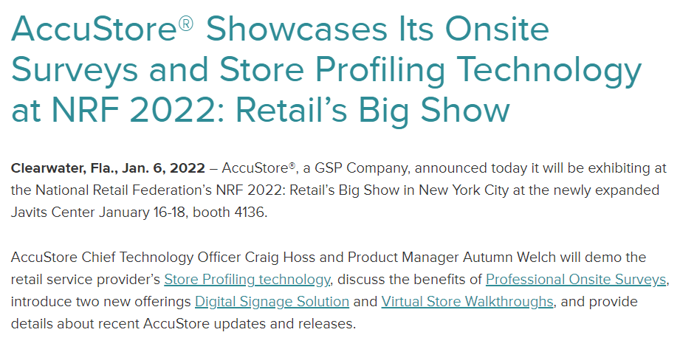
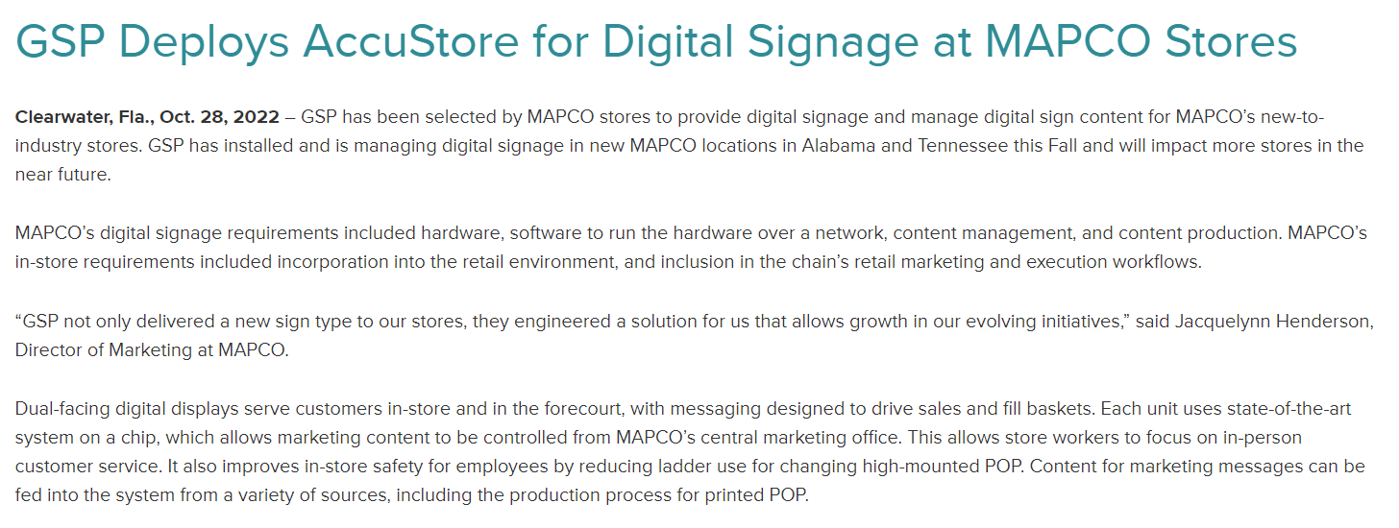
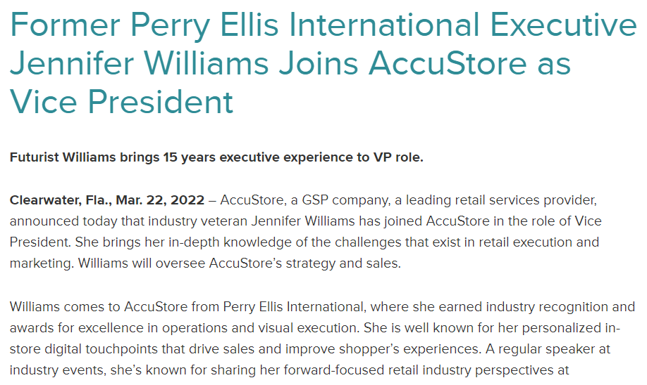
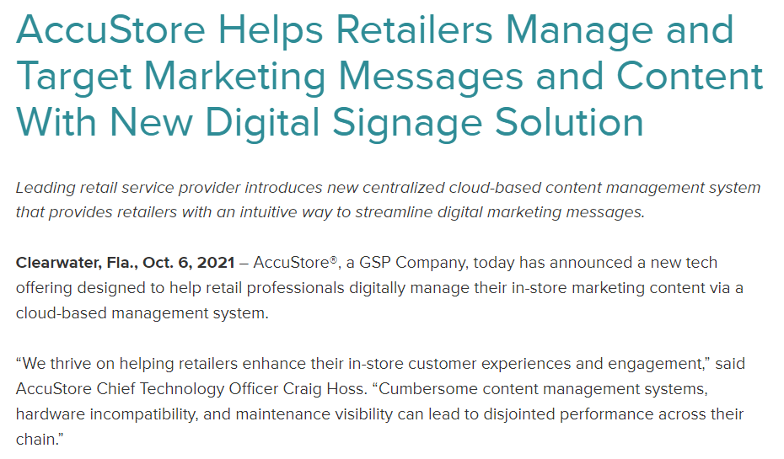
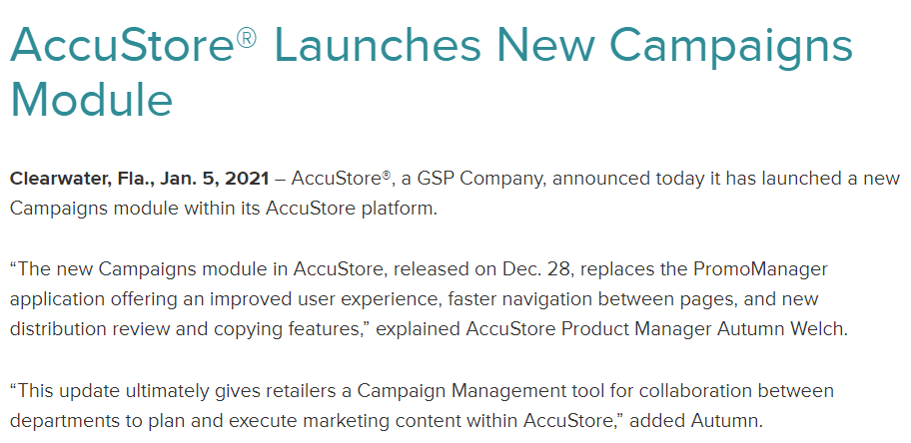
awareness - media relations
Media Relations Examples
Announce Events
Announce New Customers
Key Employee Hires
Product launch
New Module or Feature Launch

Slide 81
awareness
section 2: marketing awareness
Action Step 2: Analyst Relations

Slide 82
awareness - analyst relations
Action Step 3: Analyst Relations
  Kicking off an AR program needn't be difficult or expensive:
    Basics include identifying key firms, their areas of coverage, and specific analysts that cover your market. Most firms make this information readily available, and it is simple to add these researchers to your media lists and establish contact with the appropriate firms.
    By working within the framework of your company's PR program, begin communicating with target analysts so that they're up to date on the latest product and service developments and so that you're considered for "industry roundup" research publications, even if you're not a paying client of the analyst firm in question.
    This will contribute to "market construction" and will ultimately help your company establish a spot in the consideration set of potential customers.
Insights:
Start i right away
Move to ii and iii only after your company’s marketing content is being published consistently and is on message
After iii, consider elevating your Analyst Relations activities to a paid subscription with one of the analyst firms and pursue the Gartner Magic Quadrant/Forrester Wave applicable to your industry

Slide 83
awareness
section 2: marketing awareness
Action Step 3: Influencer Relations

Slide 84
awareness - influencer relations
Influencer Relations Overview & Action Steps
  Influencers can be anyone online or in social media considered an authority or thought leader in a particular topic area
  Influencers may share their best picks, product reviews, product comparisons, product analyses, or specific product uses online in a number of ways
  Some influencers charge money for your product to be included
  More and more, B2B buyers rely on influencers to evaluate technology decisions or identify options
Action Steps:
  Identify key influencers for CrossCap’s products
    Influencers who have already included CrossCap’s products (note any errors)
    Influencers who have covered CrossCap competitors or the general product category
  Create a campaign to contact influencers:
    Send product information (B2B marketing kit)
    Offer to provide a product demo & interview

Slide 85
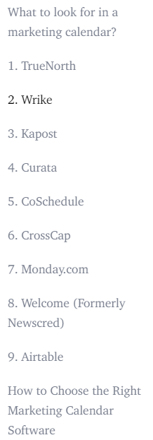
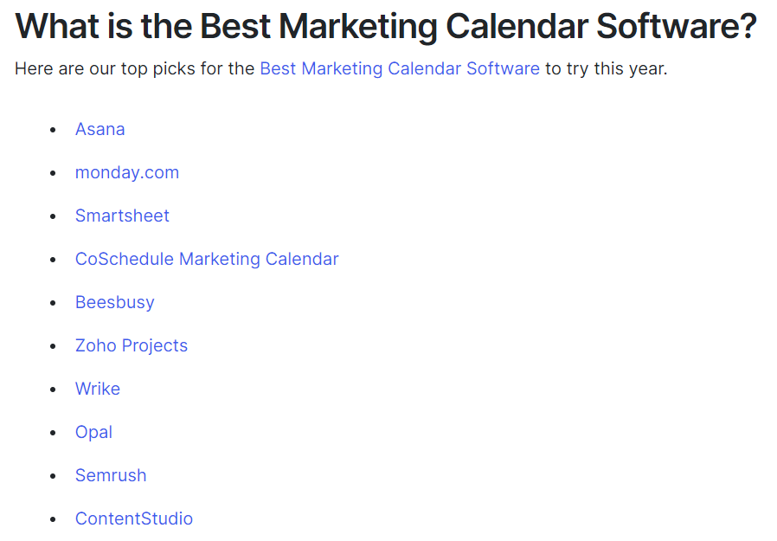
awareness - influencer relations
Influencer Relations Examples
  https://webinarcare.com/best-marketing-calendar-software/
  https://www.ventureharbour.com/marketing-calendar-software/

Slide 86
awareness
section 2: marketing awareness
Action Step 4: Sourcing & IT

Slide 87
awareness - sourcing teams
Sourcing Teams & IT
Sourcing Teams
  Section on website:
    Dedicated page to answer procurement/sourcing questions. Written in more “plain” language than the rest of the pages as this audience is not familiar with marketing
    FAQ written to a sourcing/procurement team
    Downloads of key documents sourcing can take back to their internal customers
      FAQ, Case Studies, Capabilities Statement
Actions:
Section on website directs these early influencers to self serve via the website

Slide 88
awareness - sourcing teams
Sourcing Teams & IT
IT Focus
  Section on website
    We learned from the insights interviews that the second internal group the marketing team would consult when finding software is their IT department.
    IT may be tasked with finding marketing software that works with the current enterprise software. For this reason, we want to make it easy for IT to gather technical requirements about CrossCap software
    Dedicated page to answer IT compatibility questions
    Downloads of key documents sourcing can take back to their internal customers
      Technical FAQs, Data Sheets
Actions:
Section on website directs these early influencers to self serve via the website

Slide 89
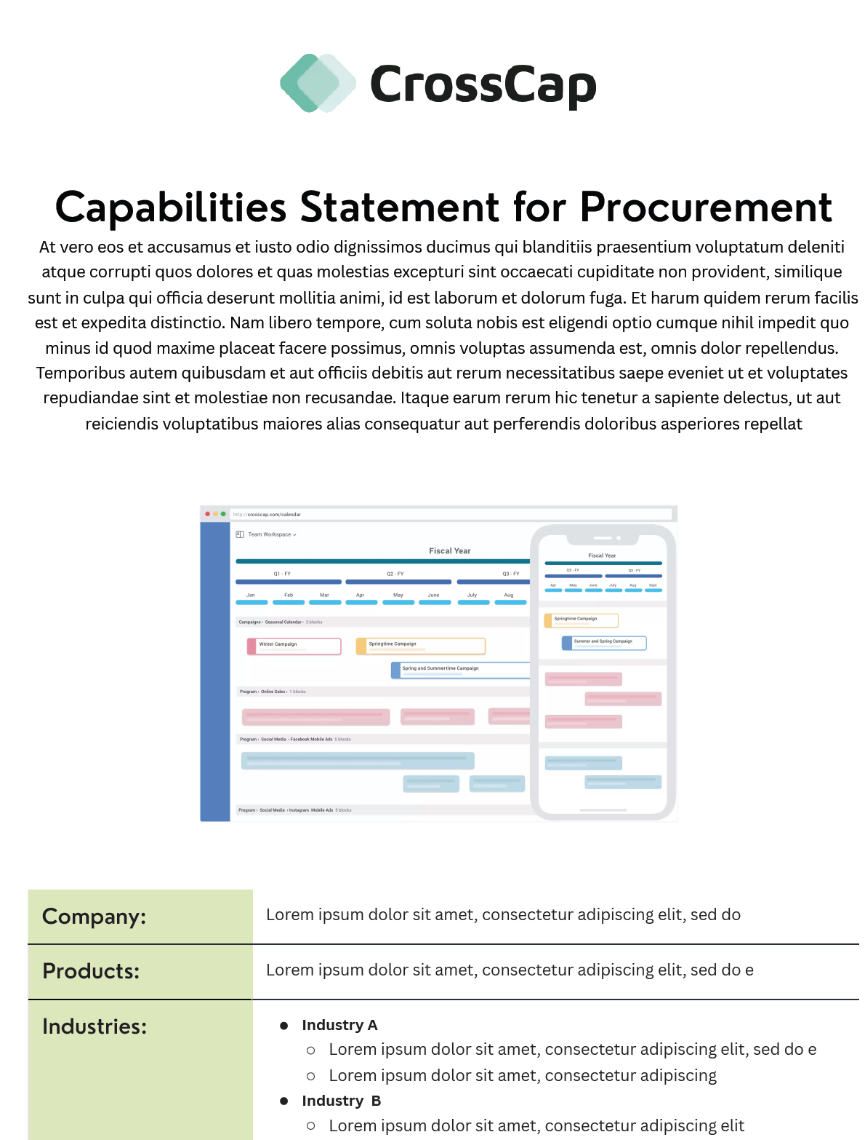
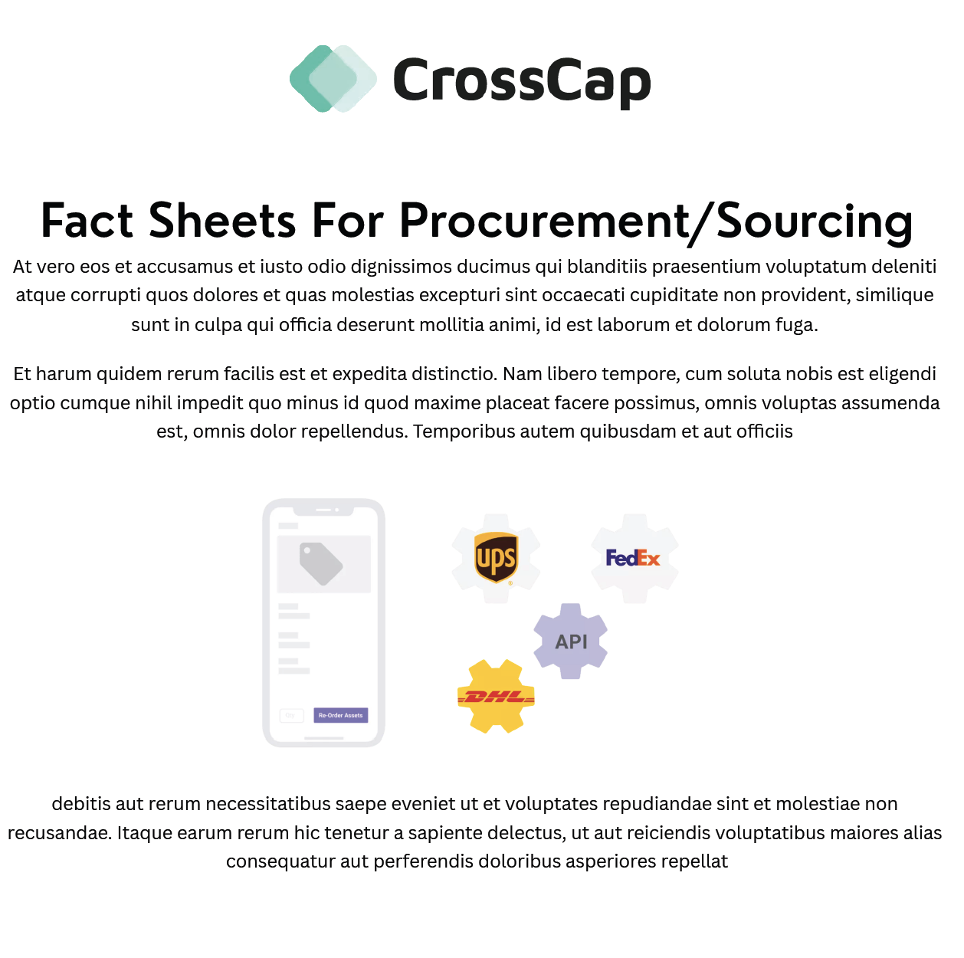
awareness - sourcing teams
Sourcing Teams & IT
Actions:
Section on website directs these early influencers to self serve via the website
All the specific information to sourcing/procurement and IT concerns are in one spot
Makes it easy for them to find and to start considering CrossCap

Slide 90
Section 3:
Marketing Lead Generation (inbound)
Actions

Slide 91
lead generation (inbound) - overview
Marketing Inbound Lead Generation Goals
  Goals: Get more ideal client traffic to the CrossCap website
    Increase inbound marketing traffic to the website through SEO, hub pages, content marketing, Google Ads and social ads
    Increase the number of sites referring traffic back to the CrossCap website, including software review sites
      Encourage more customers to leave reviews
Action Steps:
Keyword Research & SEO
SEO Hub Pages
Online Review Sites & Online Listings
Content Marketing & Social Media

Slide 92
lead generation (inbound) - keyword research
section 3: lead generation (inbound)
Action Step 1: Keyword Research

Slide 93
lead generation (inbound) - keywords & SEO
Keywords & SEO: Distro
    Store profiling/Store profiling software
    Retail signage software
    In-store signage software
    In-store Profiling
    In-store Marketing Solutions
    Promotional Planning Platform
    Merchandise Promotional Planning System
    In-store Marketing Solutions
    POP signage software
    Enterprise Marketing Management
    Inventory fulfillment and management
    Others???
Next steps
  SEO - keyword research and strategy recommended. Then with the researched and vetted recommended keywords: update onpage SEO and meta information per page; use the keywords in blog/article content;use these keywords as #hashtags (use them as a basis for hashtag research as hashtags are different than keywords) - once chosen, please add appropriate hashtags to all social media posts
Insights:
CrossCap is currently not well known as an option with ideal clients
Significant opportunity to build awareness, which will increase conversions for lead generation & direct sales activities

Slide 94
lead generation (inbound) - keyword research
Keyword Research Marketing Calendar
    Marketing Planning Software
    Marketing Calendar Software
    Enterprise Marketing Planning Software
    International Marketing Planning Software
    Global Marketing Planning Software
    Cloud based calendar tool
    Calendar planning
    Others??
  Next steps
    SEO - keyword research and strategy recommended. Then with the researched and vetted recommended keywords: update onpage SEO and meta information per page; use the keywords in blog/article content;use these keywords as #hashtags (use them as a basis for hashtag research as hashtags are different than keywords) - once chosen, please add appropriate hashtags to all social media posts
Insights:
Key for discovery - people who don’t yet know about CrossCap

Slide 95
lead generation (inbound) - hub pages
section 2: lead generation (inbound)
Action Step 2: Hub Pages

Slide 96
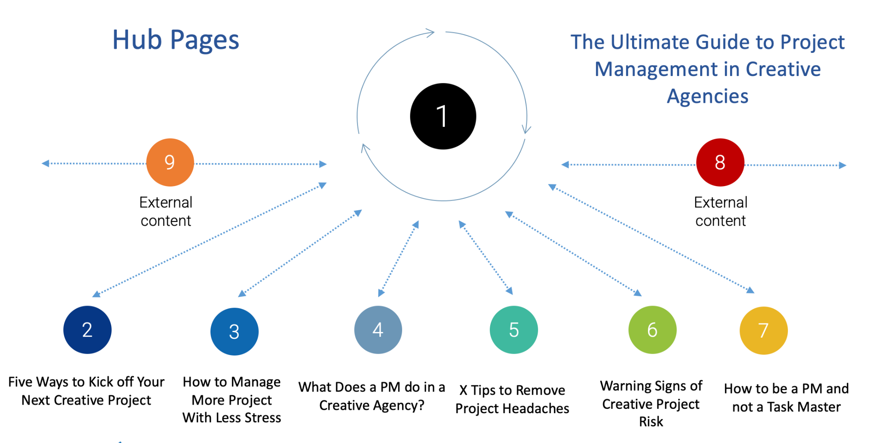
lead generation (inbound) - hub pages
The Ultimate Guide to National & Global Marketing Planning and Promotion for Large Enterprise CMOs
Enterprise Marketing - Coaching Your Team to Deliver the Marketing Insights That Matter
Strategies for When One Region Consistently Outperforms Other Country Markets
Changing Marketing Strategy In National Retail Organizations
Are Your Regions’ Customers Really That Different?
How to be More Efficient with Your Global Marketing Strategy
KPIs Key to Profitable National Campaigns

Slide 97
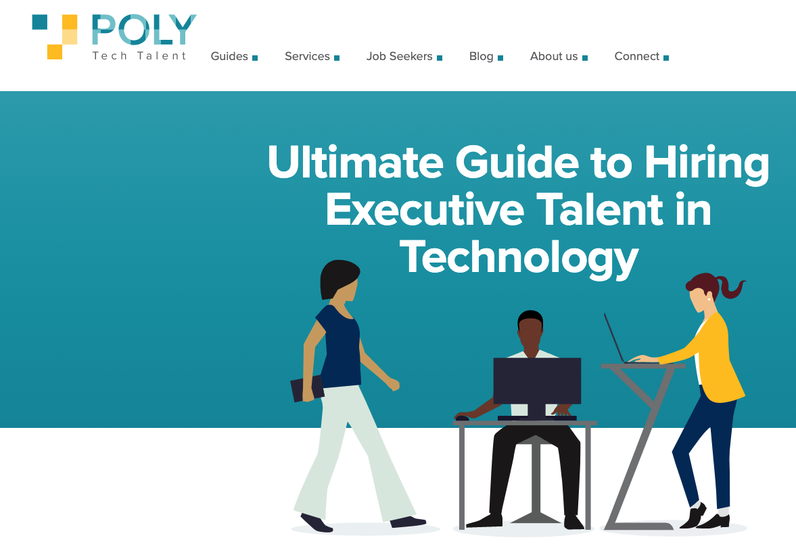
lead generation (inbound) - hub pages
Hub Page Example
Insights:
Hubpages are a way to organize your content. It makes it easy for your persona to find all the information applicable to them in one spot.
The alternative is leaving them to search through your site for content applicable to them. Which unfortunately, they will not do.
Make it easy for your persona to know CrossCap supports them, “gets” them, can help them.
https://polytechtalent.com/guide-to-hiring-executive-talent/

Slide 98
lead generation (inbound) - hub pages
Hub Page: CMO - Distro
  The Ultimate Guide to Multi-Location In-store Marketing for
  Large Enterprise CMOs
Company Growth
  CMO’s responsibility for the company growth
Technology
  CMO’s responsibility to get their team the right tools
Customer Experience (CX)
  CMO’s responsibility for the customer experience
Regional-Specific Marketing
  CMO’s responsibility for marketing: regional differences
Internal Teams & Suppliers
  CMO’s responsibility for right team/vendors
Sales Enablement
  CMO’s responsibility to set up sales for success
Highlights:
Persona driven content specifically for this targeted buyer
Blogs are written at the strategic level to show CMOs CrossCap is a strategic must have solution
Demonstrates deeper understanding of your CMO’s problems that CrossCap helps solve

Slide 99
lead generation (inbound) - hub pages
Hub Page: CMO - Distro (in detail)
  Company Growth
    Ensuring in-store campaigns lead to bottom-line growth for the organization
    ebook: The all new Retail Marketing Essentials for the CMO
  Technology
    Is controlled access delaying your team’s ability to perform?
    Marketing inventory eating away at your bottom line?
  Customer Experience (CX)
    The value of the CMOs store walk
    Digital signage and accessibility for your customers
  Regional-Specific Marketing
    Keeping up with your regional marketing team
    Does your regional in-store marketing need to be so regionally specific?
  Internal Teams & Suppliers
    Running multi-team collaboration in web & mobile
    Collaborate with multiple suppliers on project tasks
  Sales Enablement
    How to save millions on in-store signage and still drive profitable sales
    How to Measure Sales Lift in a National Retail Promotion
Highlights:
Persona driven content specifically for this targeted buyer.
Written at the strategic level to show CMOs CrossCap is a strategic must have solution
This is a content outline of recommended blog topics, this information is already known internally - now share it.
More topics added each month, living page on website

Slide 100
lead generation (inbound) - hub pages
Hub Page: CMO - Marketing Calendar
  The Ultimate Guide to National & Global Marketing Planning and Promotion for Large Enterprise CMOs
Company Growth
  CMO’s responsibility for the company growth
Technology
  CMO’s responsibility to get their team the right tools
Customer Experience (CX)
  CMO’s responsibility for the customer experience
Regional-Specific Marketing
  CMO’s responsibility for marketing: regional differences
Internal Teams & Suppliers
  CMO’s responsibility for right team/vendors
Sales Enablement
  CMO’s responsibility to set up sales for success
Highlights:
Persona driven content specifically for this targeted buyer
Blogs are written at the strategic level to show CMOs CrossCap is a strategic must have solution
Demonstrates deeper understanding of your CMO’s problems that CrossCap helps solve

Slide 101
lead generation (inbound) - hub pages
Hub Page: CMO - Marketing Calendar (in detail)
  Company Growth
    How to keep your organization aligned towards the same marketing goals
    Visibility to orchestrate your marketing campaigns & tactics
  Technology
    Explaining marketing data in multiple ways for key stakeholders
    Improving data quality for informed strategic marketing decisions
  Customer Experience (CX)
    How to quickly assess performance KPIs and year-over-year comparisons
    Why adaptable marketing planning benefits your customer
  Regional-Specific Marketing
    Expertly define the marketing mix for customer/regional segments
    How to get global visibility on marketing campaigns and why it matters
  Internal Teams & Suppliers
    Which marketing insight are right for which team members?
    When vendors become partners - how much information helps or hurts?
  Sales Enablement
    Marketing speak - supporting sales and the customer journey
Highlights:
Persona driven content specifically for this targeted buyer.
Written at the strategic level to show CMOs CrossCap is a strategic must have solution
This is a content outline of recommended blog topics, this information is already known internally - now share it.
More topics added each month, living page on website

Slide 102
lead generation (inbound) - hub pages
Hub Page: Marketing Operations - Distro
  The Ultimate Guide to Large Enterprise Marketing Operations for Multi-Location In-store Signage
People
  M. Ops responsibility for team/vendors
Planning/Process/Delivery/Execution
  M. Ops responsibility for the work getting done
Technology
  M. Ops use technology for work completion
Marketing
  M. Ops balance of execution vs. strategic thinking
Highlights:
Persona driven content specifically for this targeted buyer.
Written at the operational level - talking directly to the daily users of the software

Slide 103
lead generation (inbound) - hub pages
Hub Page: Marketing Operations - Distro (in detail)
  People
    How to collaborate with multiple suppliers on project tasks
    Most efficiently manage the entire commercial print vendor process.
    Is low cost best? How to compare bids and select preferred vendor
  Planning/Process/Delivery/Execution - Managing the Beast
    Leading multi-team collaboration in web & mobile
    Tips for integrated workflows between regions
    Reorder chaos - how to ensure accurate reorders and inventory tracking
  Technology
    Managing smart location profiling and kitting
    Renovations/openings/closing managing change with technology
  Marketing
    Manage and executive store walks with ease - what they need to know
    Keeping on budget - how to track and analyze costs for signaget matters
Highlights:
Persona driven content specifically for this targeted buyer.
Written at the operational level - talking directly to the daily users of the software

Slide 104
lead generation (inbound) - hub pages
Hub Page: Marketing Operations - Marketing Calendar
  The Ultimate Guide to National & Global Marketing Planning and Promotion for Large Enterprise Marketing Operations Leaders
People
  M. Ops responsibility for team/vendors
Planning/Process/Delivery/Execution
  M. Ops responsibility for the work getting done
Technology
  M. Ops use technology for work completion
Marketing
  M. Ops balance of execution vs. strategic thinking
Highlights:
Persona driven content specifically for this targeted buyer.
Written at the operational level - talking directly to the daily users of the software

Slide 105
lead generation (inbound) - hub pages
Hub Page: Marketing Ops - Marketing Calendar (in detail)
  People
    How to better explain marketing campaign plans to your team
    Managing change - how to keep on top of global marketing deliverables
    Who does what - how to control access without limiting productivity
  Planning/Process/Delivery/Execution - Managing the Beast
    2023 social media
    2023 marketing calendar
    (ebook) how to choose the best marketing calendar software
  Technology
    Tame the complexity how to manage multiple campaign calendars for brands, geographic regions, or marketing channels
    Using dashboards for quick metrics views
  Marketing
    Export data for key stakeholders and elevate your achievements
Highlights:
Persona driven content specifically for this targeted buyer.
Written at the operational level - talking directly to the daily users of the software

Slide 106
lead generation (inbound) - content marketing & social media
section 2: lead generation (inbound)
Action Step 3:
Online Listings & Review Sites

Slide 107
lead generation (inbound) - review sites & online listings
SAAS Review Site & Online Listings
SaaS Review Sites & Online Listings (citations)
  Software review sites: Capterra, G2, GetApp - you already appear on these sites.
    Update messaging and descriptions of all products
    Two phases
      update/correct listing
      request reviews
  If you want to know which review sites to prioritize, search for “[your category] + reviews,” “Best + [your category],” or “List of [your category] companies.” The higher a review site appears in the organic search engine results, the more likely your audience goes there to seek reviews on your software and others in your category. Most software buyers find review sites by online search.
  Gartner Digital Markets: Capterra, GetApp, and SoftwareAdvice
  Capterra Software Advice GetApp
  Gartner Peer Insights TrustRadius PeerSpot (Formerly IT Central Station)
  Trustpilot SoftwareReviews
Insights:
Correct listings are key
Review campaigns need be ongoing and owned by someone in the company to ensure consistency

Slide 108
lead generation (inbound) - review sites & online listings
SAAS Review Sites & Requesting Reviews
SaaS Review Sites & Requesting Reviews
Software reviews need a strategy. Answer the following before starting:
  Which team or function owns review generation ownership? Customer marketing, product marketing, or another team?
  Will you ask all of your users for reviews or your happiest users only?
  Will you generate reviews with an always-on approach or with a campaign approach?
  Will your review generation be review-site driven or vendor-driven?
  Will you manually send review requests or automate review requests?
  Will you incentivize reviewers?
  Will you ask your main point of contact or user for a review, or will you ask multiple people at a customer account for reviews?
  Will you keep it simple with an email-driven review generation approach, or will you try multiple channels?
Insights:
Correct listings are key
SaaS Review Sites campaigns need be ongoing and owned by someone in the company to ensure consistency
This will involve upgrading your subscription (paid) to the SaaS review sites
Commit to a certain number of reviews per site by the end of the year

Slide 109
lead generation (inbound) - review sites & online listings
“Regular” Online Listings
“Regular” Online Listings (directories, citations)
  Google pulls information about your company from websites other than your own company website
  In a sense Google “checks” how your company information shows up on other sites
  If information is not consistent (Business Name, Address, Phone no. - NAP being the first item checked) it makes Google “think” your business information may not be correct - Google doesn’t want to return sub par information in its searches
  Know that major social media sites are considered by Google to be directories - it is key that all the information fields are filled out to help Google, help your company
  These regular online listing sites often also have the review feature - for example Google Business Profile with Google Reviews, Facebook with Facebook Business reviews and so on
Insights:
Google pulls/verifies your business information with other sites
Consistent company information on “non” SaaS sites matters
May be easier for company reviews

Slide 110
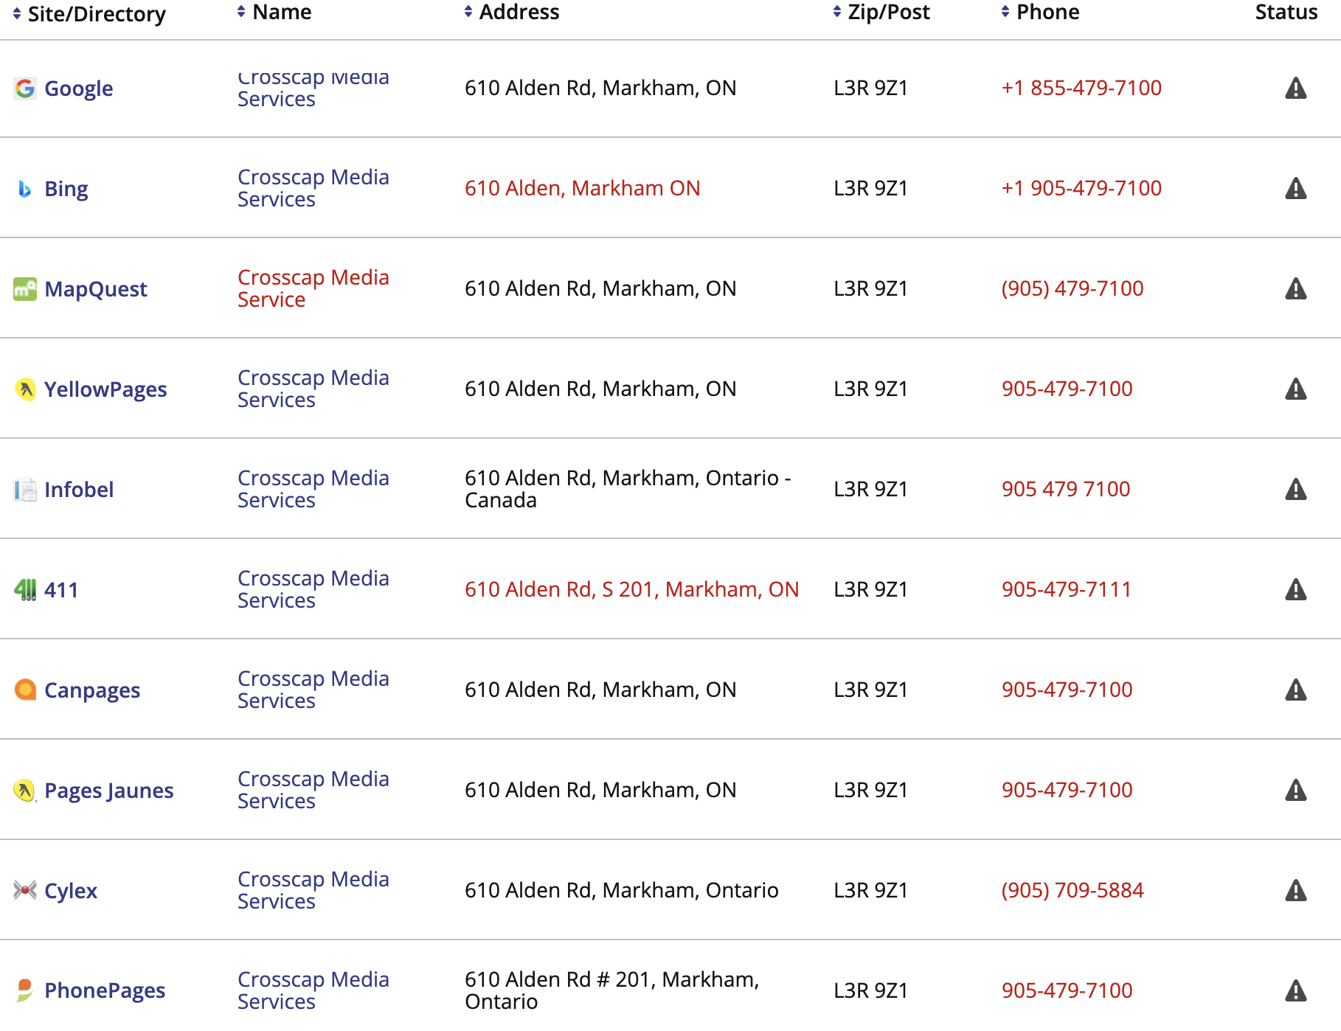
lead generation (inbound) - review sites & online listings
“Regular” Online Listings
Insights:
Decide the name, full address and phone number for your business
Clean up citations

Slide 111
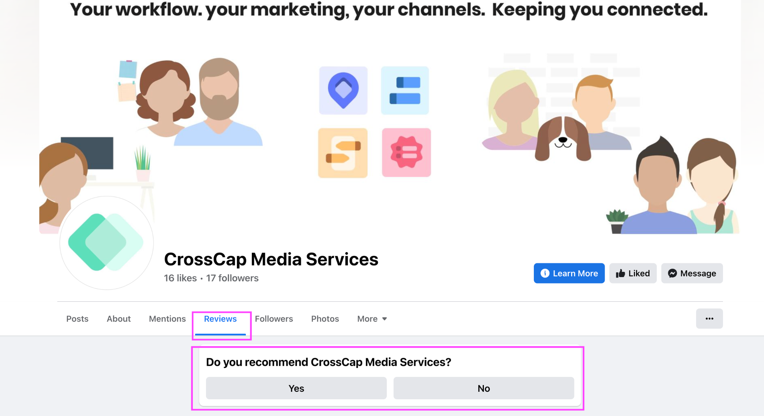
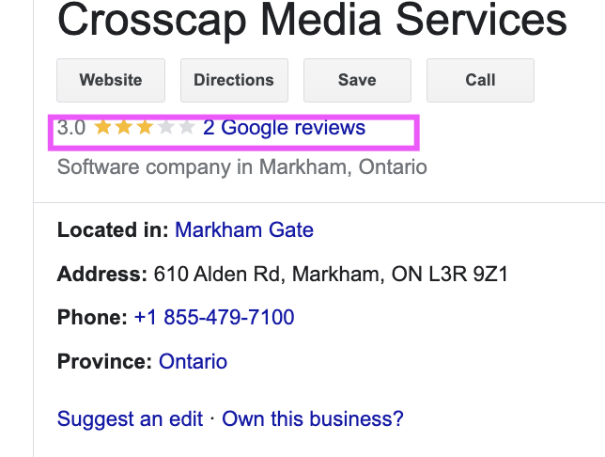
lead generation (inbound) - review sites & online listings
“Regular” Online Listings
“Regular” Online Listings Reviews
  Google reviews, Facebook reviews - perhaps easier to request - too compared to the SaaS sites which don’t do “general” company reviews
  Consider using Google and Facebook reviews for general company feedback, employee feedback (choice of here or Glassdoor)
  Can feel less daunting and less formal for the reviewer
  Still needs a strategy to implement, unfortunately online reviews don’t just happen.
Insights:
Google pulls/verifies your business information w/other sites
Consistent company information on “non” SaaS sites matters
May be easier for company reviews

Slide 112
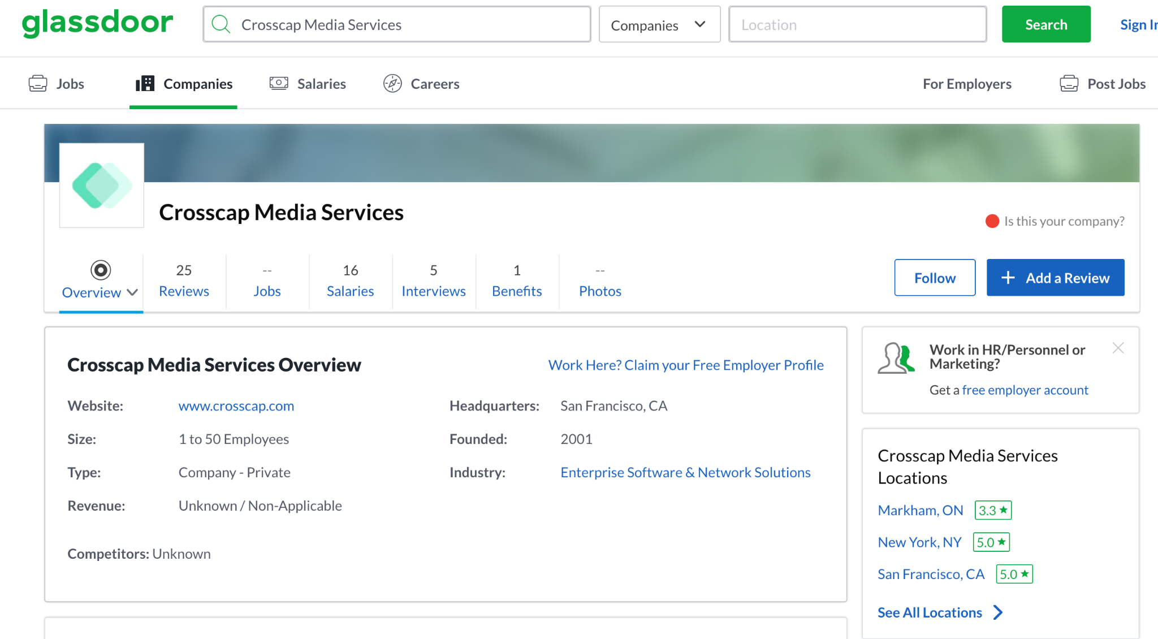
lead generation (inbound) - review sites & online listings
Employer Review Sites
Glassdoor
Insights:
People are already directing the conversation without your company’s input
Claim and take seriously
C

Slide 113
lead generation (inbound) - content marketing & social media
section 2: lead generation (inbound)
Action Step 4:
Content Marketing & Social Media

Slide 114
lead generation (inbound) - content marketing & social media
Content Marketing Why
  Why? Your ongoing content is the cornerstone of your marketing
    Each piece of content can support your strategy through many levels from Know through Like, Trust and Try - as well as Repeat & Refer
    Your content can keep working for you over time and be repurposed
    It gives you something to continually share with your prospects & customers
  Who? All Personas
  What? Blog, Social Media, Videos, eBooks/guides/worksheets, Case Studies/Testimonials - Hub Pages
  Action Steps: Ongoing Content Plan + Social Sharing + Hub Pages

Slide 115
lead generation (inbound) - content marketing & social media
Content Marketing Action Steps
  Content Calendar: Create a six month to one year content calendar outlining monthly themes and content pieces
  Core Content Pieces
    The materials we create for your funnels and B2B content kits become your core content
    Share new content piece on Social Media & use in Campaigns
    Use core content as inspiration for ongoing content sharing (blogs, videos, social posts, etc.)
  Regular Blog Posts:
    Identify an SME and create one long form educational blog post monthly
    Create three additional blog posts related to the monthly themes
    In one year you can add 48 new pages to your website addressing key ideal client needs & working for you in terms of SEO
  Social Sharing:
    Share all content on Facebook, LinkedIn (Page/Group), and Instagram (four posts per blog and asset)
  One LinkedIn Article Monthly
  Monthly Newsletter- get started and get consistent
  Content Updated on Hub Pages

Slide 116
lead generation (inbound) - content marketing & social media
Better Content With Interviews: Our Process
  Challenge: Create large volume of content consistently
  Goal: Integrate emotional messaging AND sophisticated, insightful SEO’d writing
  Action Steps: Use the blog interview method to achieve quantity goals while elevating CrossCap SMEs profile in the industry

Slide 117

lead generation (inbound) - content marketing & social media
Better Blogs With Interviews Our Process
  SME is interviewed by our writers over recorded Zoom call. 1hr = 2-3blogs/pcs of content
  Draft is reviewed/approved
  Posted on website as blog + image
  Posted on social media in rotation
  1 week later, posted on SME’s LinkedIn as article
    Raises their professional profile with existing & potential clients
    SME builds thought leadership & feels appreciated
    Saves time, SMEs typically enjoy the process
    SME retention, committed, invested in success

Slide 118
Newsletter
  One newsletter - monthly
  Choose reliable email marketing software (Hubspot)
  Collect all active and prospect customers for list
  First issue - launch and explain - why we are doing this, why you are on the list, how to unsubscribe, what we mail about
  Ongoing:
    Marketing Calendar - new tip each issue (new use case)
    Distro - new tip each issue (new use case)
    New customers
    New updates
    Employee feature
    Request a demo
Insights:
An additional touch point to those in the sales cycle
Showcase other ways to use the software - request customers voiced in the insights interviews
Additional touch point to existing clients between calls
Showcases your success & expertise
Start of a funnel into CrossCap - by those signing up via social

Slide 119
Section 4:
Marketing Lead Generation (outbound)
Actions

Slide 120
lead generation (outbound)
Lead Generation (outbound) Goals
  Challenge: CrossCap needs to significantly increase awareness & leads for both the Marketing Calendar & Distro products
  Goals: Get more new marketing qualified leads into the email nurture sequence (so they will eventually convert to sales qualified leads)
Action Steps:
Association & Event Marketing
Account Based Marketing Campaigns
Social Advertising
Google Search Advertising

Slide 121
lead generation (outbound)
section 4: lead generation (outbound)
Action Step 1:
Association & Event Marketing

Slide 122
awareness - media relations
Associations/Events Overview
Action Steps:
  Create an association & event marketing kit, including templates
  Identify key associations and events for both Distro and Marketing Calendar
  Identify the best associations to join as members, and the best marketing opportunities to take advantage of
  Identify the best events to attend/sponsor and the best marketing opportunities to take advantage of
  Create integrated marketing campaigns for EACH of these opportunities - driving to CrossCap’s lead nurturing funnels.
  Industry associations and events are one of the fastest ways to build awareness & generate leads with your ideal clients
  When you don’t have a large audience of your own, you can use associations and events to access other people’s audiences (and your ideal clients)
  Use a strategic and integrated marketing approach - this is not about showing up at a booth
  Associations & events offer a large number of marketing opportunities - and we can integrate these with our internal marketing funnels to maximize results

Slide 123
lead generation (outbound) - associations & events
Associations/Events Create Marketing Kit
  Create an association marketing kit for each of CrossCaps main products
  Marketing kit will include:
    Messaging guide and key message snippets to use
    News release template
    Advertising template
    Event Marketing sheet template
    Advertising template
    Direct mail template
    Email template
Insights:
Creating a templated event & association marketing kit ahead of time means:
  You can more quickly take advantage of opportunities
  You don’t have to recreate the wheel each time
  You keep your messaging & marketing consistent

Slide 124
lead generation (outbound) - associations & events
Event/Association Marketing Research Example - Distro
Associations | Events
National Retail Federation: National & state level | NRF: Big Show & Retail Week - New York - January
Retail Industry Leaders Association Retail Innovation Center | NRF Nexus: July
National Grocers Association | eTail: Palm Springs Feb 27-March 2
National Shoe Retailers Association | ShopTalk: March 26-29 - Las Vegas
Retail Council of Canada | Retail Innovation Conference June 13-15 - Chicago
Terry J. Lundgren Center for Retailing | World Retail Conference: Barcelona - April 25-27
 | Global Retailing Ideas Summit - San Francisco March 16-17
 | Future Stores Miami - March 5-7 Future Stores Seattle June 20-22
 | GroceryShop - Las Vegas - Sept 18-21
 | RCC Store 23 (Canada) Toronto - May 30-31
 | NACS (Convenience & Fuel Stores)
  Identify associations & events focused on the Retail sector
  Review opportunities & fit to target market
  Select associations to target

Slide 125
lead generation (outbound) - associations & events
Event/Association Marketing Research Example - Marketing Calendar
Associations | Events
AdWeek (CMO focus areas) | AdWeek NexTech - December
ANA - Global CMO Growth Council | Martech
WSJ CMO Network | ANA Masters of Data and Technology
International Association of Digital Marketing Professionals | Adobe Summit
Canadian Marketing Association | Strategic Marketing 2023 - May 8-9, San Diego
American Advertising Federation | Content Marketing World
American Marketing Association | B2B Marketing Summit
Direct Marketing Association | Forrester B2B Summit
World Business Forum | Connect CMO Leadership Summit
 | World Business Forum Marketing Summit
 | Gartner Marketing Symposium
 | Inbound - Hubspot
 | Social Media Marketing World
  Identify associations & events focused on the Retail sector
  Review opportunities & fit to target market
  Select associations to target

Slide 126
lead generation (outbound) - associations & events
Association Marketing Recommendation
  Associations:
    Join 1 to 2 associations this year
      The NRF
      Retail Industry Leaders Association
    Choose 1 to 2 association marketing activities this year
      Recommend:
        Advertising in the newsletter using a direct response ad driving back to the CrossCap landing page and leading into the new lead nurturing funnel
        Contributing a news release or whitepaper, if possible
Insights:
Recommend focusing 2023 on Retail events & associations
Ideal clients for both main products attend these events
Opportunity to test association marketing & systems while promoting both products
Move into more marketing focused events in 2024

Slide 127
lead generation (outbound) - associations & events
Recommended 2023 Associations & Events: NRF
Association Marketing - NRF:
  Join the National Retail Federation as an Industry Partner Member ($2500)
    Benefits:
      Submit news releases, research & white papers for consideration
      Advertise in the NRF newsletter ($5,000)
      Email targeted members
      Reduced fees for events & partnerships
  Sponsor the NRF Retail Industry Leadership Series (est. $5,000 to $15,000)
    Includes recognition by email, social media before and after event, and during webinar

Slide 128
lead generation (outbound) - associations & events
Event Marketing Recommendation
  Events:
    Attend 1 to 3 events this year
      Recommend NRF Nexus (attendance + sponsorship) $15 to 35,000
      Retail Innovation Expo (booth + marketing)
      FutureStores (booth + marketing)
      Note: the NRF Big Show is ideal but happening next week
    Create an integrated event marketing strategy including:
      Website marketing page for the conference (see example: https://www.elasticpath.com/resources/events/nrf-2023)
      News release announcing conference sponsorship or attendance
      Key call to action: Download an important whitepaper
      Booth with B2B marketing materials and CTA (for Retail Innovation Expo - no booth for NRF Nexus)
      Pre and post show mailing lists - driving to the website whitepaper download and nurture sequence
      Brochure in attendee bag (driving back to whitepaper download & nurture sequence)
      Holding an event, if possible (NRF big show)

Slide 129
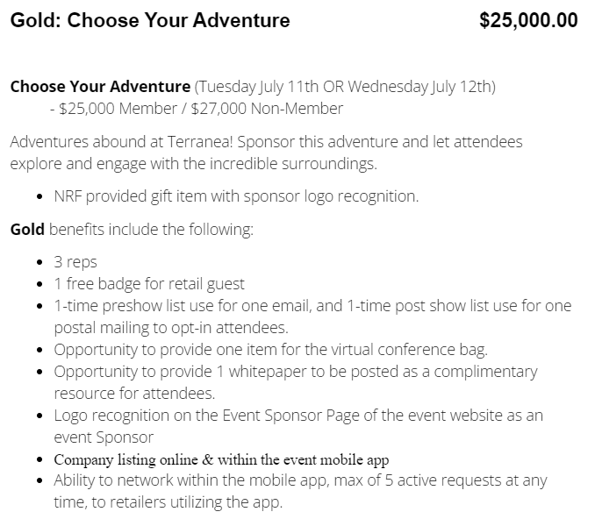
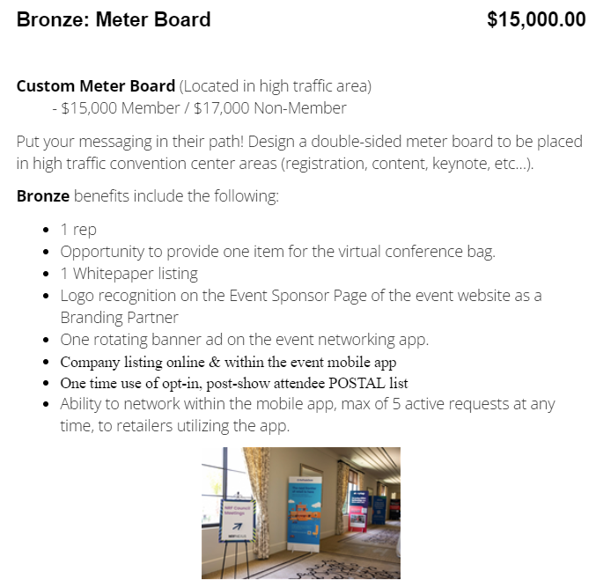
lead generation (outbound) - associations & events
Recommended 2023 Associations & Events: NRF
  Sponsor the NRF Nexus Event (July 10-12 - Rancho Palos Verdes, California)
    NRF Nexus represents a unique gathering of 300 decision-makers from leading retail organizations across marketing, technology and digital.
  Note: the NRF Big Show is ideal
  but happening next week -
  recommend attending in January 2024

Slide 130
lead generation (outbound) - associations & events
NRF Nexus Sample Marketing Plan:
Media/Social/ Newsletter Announcement
CrossCap Event Landing Page with CTA
Lead Nurturing Sequence
Book a Demo
Pre-Show At Show Post Show
Pre-Show Email
Product Brochure in Attendee Bag
Post Show Email or Direct Mail Piece
Invite VIP Retail Guest
3 Company Reps at Show - Network in Mobile App
Sales Follow Up with Key Contacts
Logo on Event Gift
Whitepaper Posted as a Resource
Company Listing, Logo on Website & Sponsor Page

Slide 131
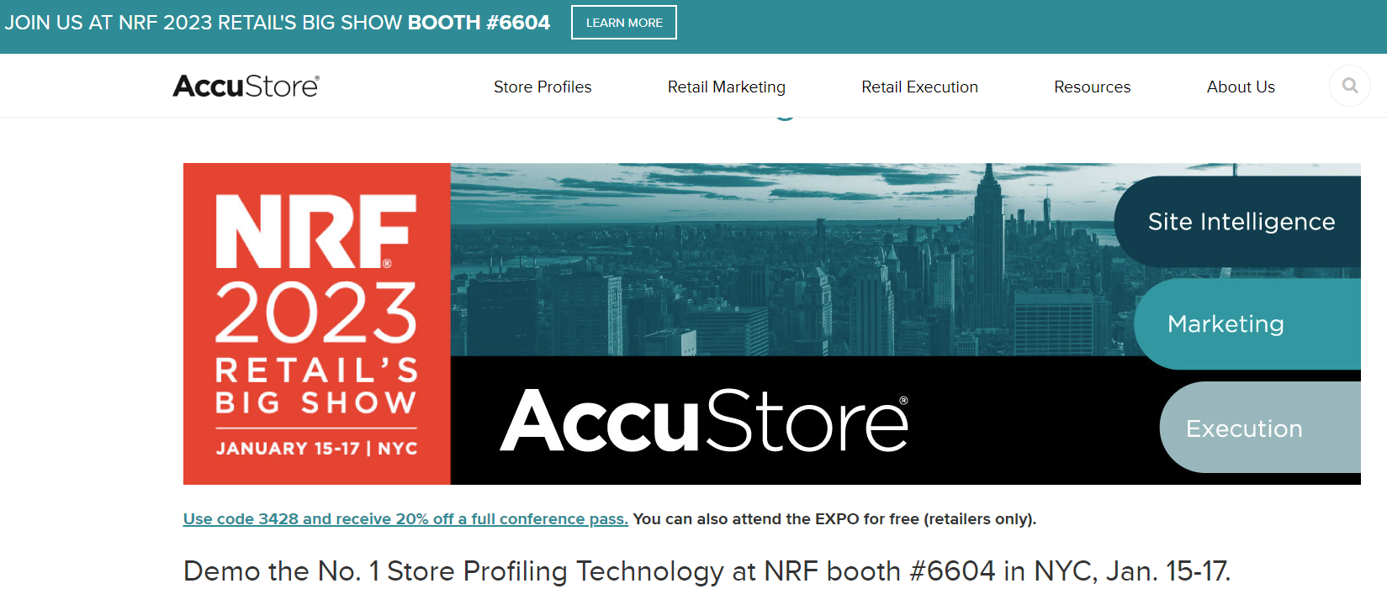
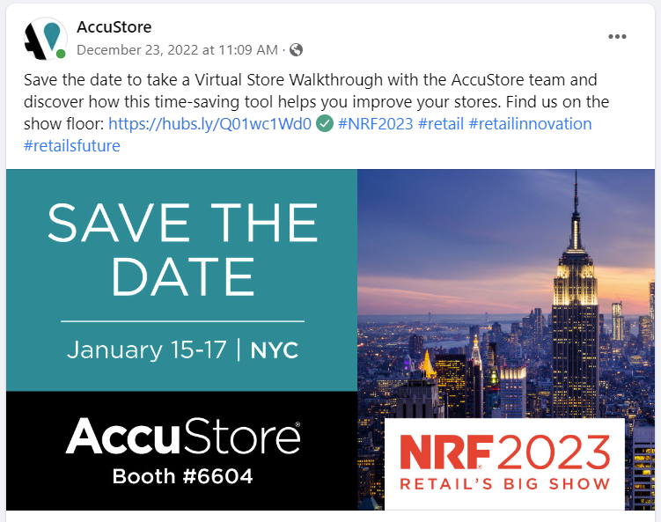
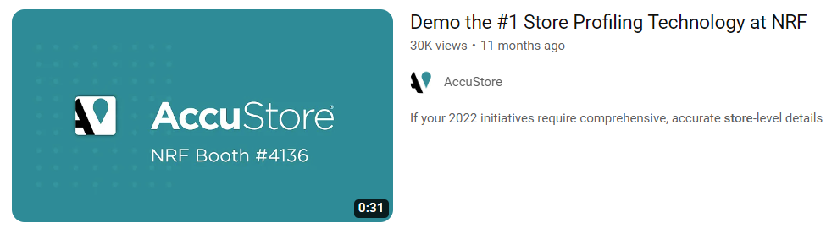
lead generation (outbound) - associations & events
Event & Association Marketing Example - Distro
  Website marketing page for the conference: https://www.accustore.com/nrf-big-show/

Slide 132
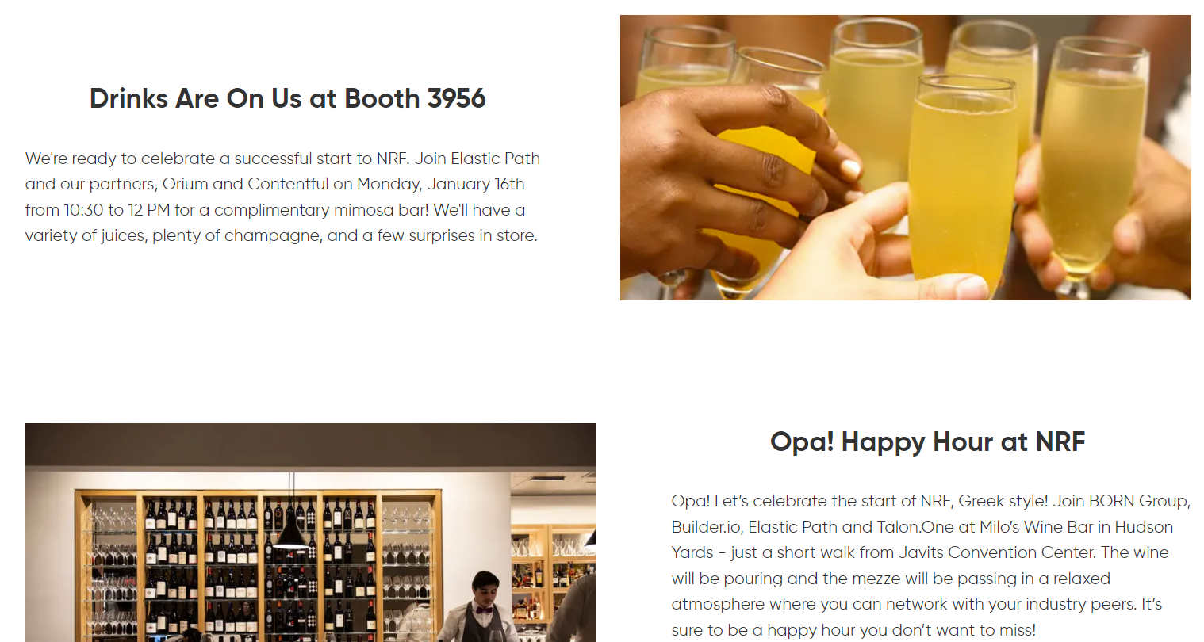
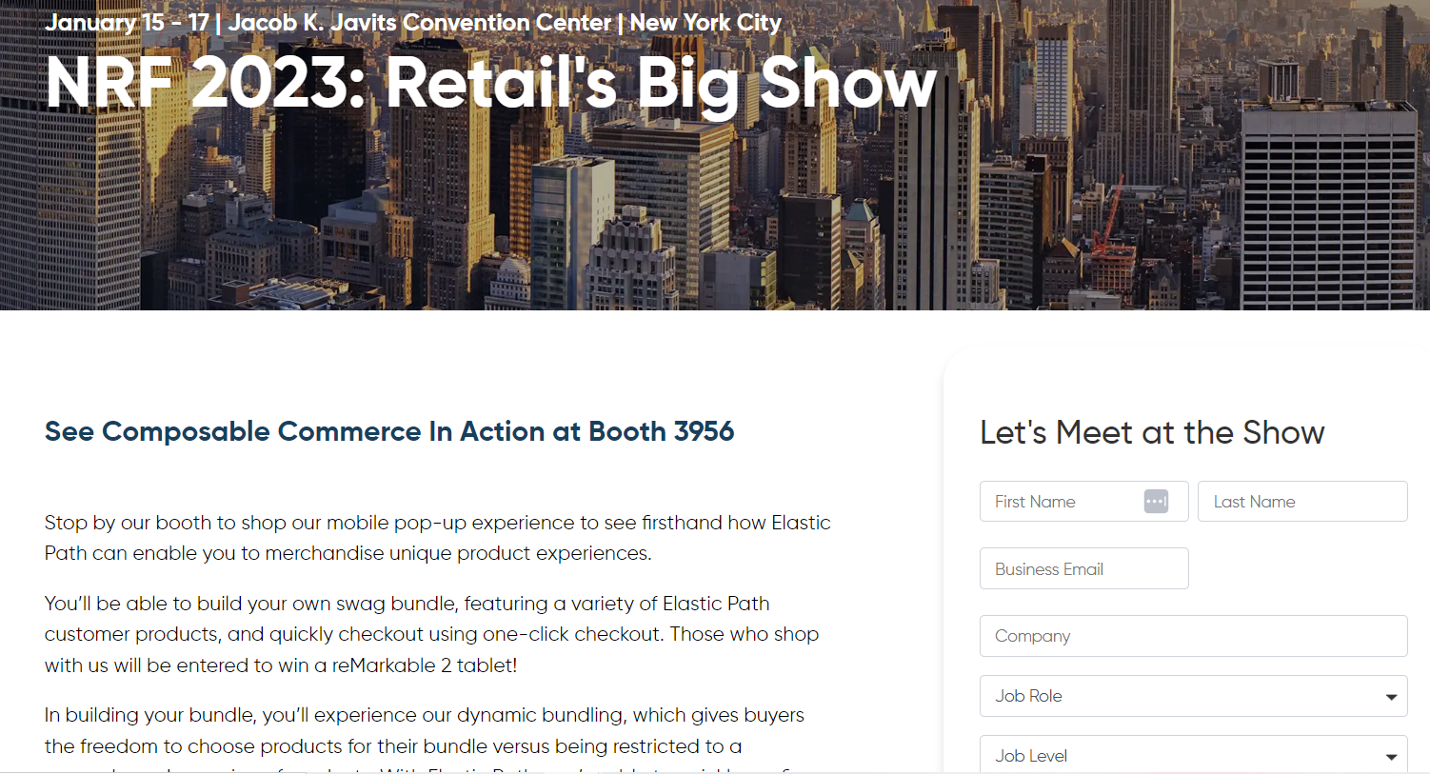
lead generation (outbound) - associations & events
Event & Association Marketing Example - Distro
  Website marketing page for the conference:
    https://www.elasticpath.com/resources/events/nrf-2023

Slide 133
lead generation (outbound)
section 4: lead generation (outbound)
Action Step 2:
Account Based Marketing

Slide 134
lead generation (outbound) - targeted account campaigns
Account Based Marketing
Account-Based Marketing is a focused approach to B2B marketing in which marketing and sales teams work together to target best-fit accounts and turn them into customers:
  Identify highly qualified accounts using research, published lists and existing knowledge:
    Use LinkedIn and website to identify key contacts, including:
      CMO and Executive Assistant
      VP/Director of Marketing Operations
      Marketing Operations Manager
      Sourcing/IT
  Create an integrated marketing-sales campaign to target each account, including:
    Website page targeting the specific account - including all the information they would need, including a personalized video - Page would have a key download opportunity and drive to request a demo or a consultation
    LinkedIn outreach - LinkedIn direct account advertising
    Direct mail or email - to all key contacts
    Referral outreach, if possible
    Direct sales follow-up
  Recommend targeting one account monthly, either alternating between Marketing Calendar & Distro or combining

Slide 135
lead generation (outbound)
section 4: lead generation (outbound)
Action Step 3:
Social Advertising

Slide 136
lead generation (outbound) - social media advertising
Social Media Advertising
  Social media advertising is ideal for reaching new audiences (interrupting) who don’t yet know that CrossCap and their products exist (increasing awareness) and generating initial leads
  Recommend separate campaigns for the two main product lines: Distro and Marketing Calendar
  Consider the following social platforms & spends:
    LinkedIn ($500+ per product monthly)
      Ideal for reaching all personas
      Ideal for Account Based targeting
    Facebook ($500+ per product monthly)
      Ideal for reaching marketing operations persona, will also reach CMOs
    Instagram ($500+ per product monthly)
      Ideal for reaching marketing operations persona, will also reach CMOs
  All campaigns will move leads to a main CTA download and the appropriate lead nurture sequence

Slide 137
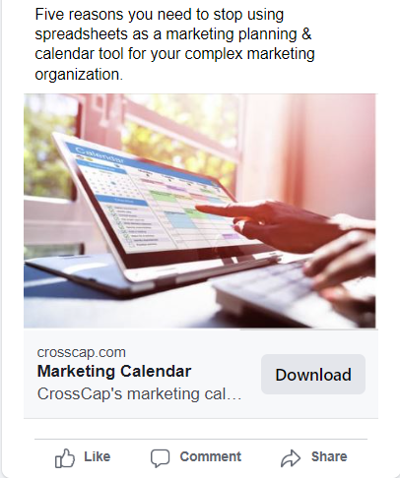
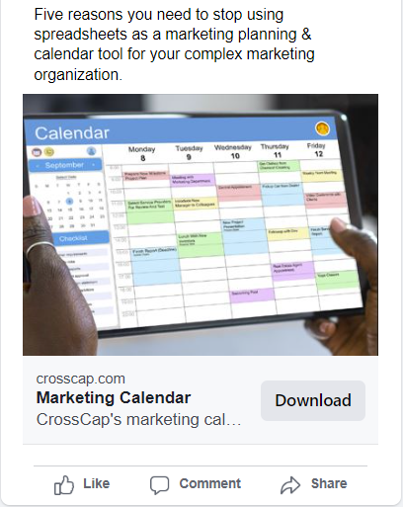
lead generation (outbound) - social media advertising
Social Media Advertising product focus examples

Slide 138
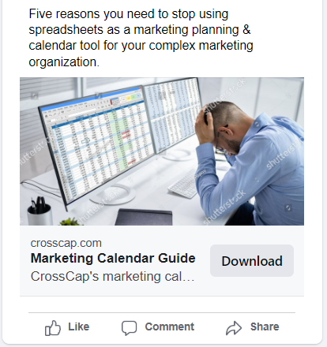
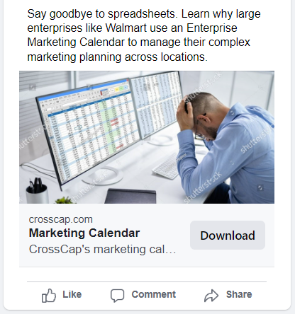
lead generation (outbound) - social media advertising
Social Media Advertising problem focus examples

Slide 139
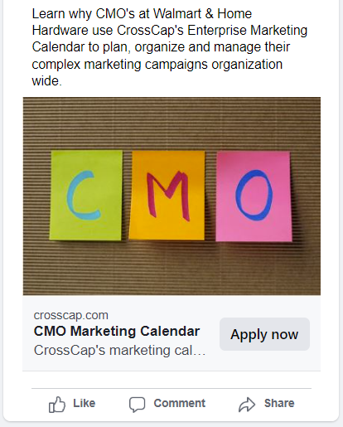
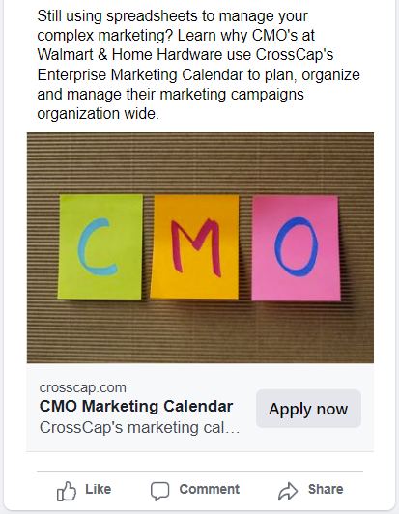
lead generation (outbound) - social media advertising
Social Media Advertising persona focus example

Slide 140
lead generation (outbound)
section 4: lead generation (outbound)
Action Step 4:
Google Search Advertising

Slide 141
lead generation (outbound) - google advertising
Google Search Advertising
  Google search advertising is ideal for reaching prospects who are actively searching for a product similar to CrossCap and are at the consideration and decision stages.
  Google search advertising is ideal for getting more traffic to the CrossCap website, which will in turn increase initial marketing qualified leads on the website
  Google ads can augment SEO programs while they are in development and gaining traction
  Recommend Google advertising for the Marketing Calendar product - prospects are actively searching for a product similar to marketing calendar
  Recommend further research or a test campaign for Distro - prospects may not be actively searching for a product similar to Distro - may need to target other searches
  Google ads would lead to a unique landing page with a main consideration/decision making CTA to book a demo, and download the product spec sheet
  Spend recommendation: $1,000 monthly+

Slide 142
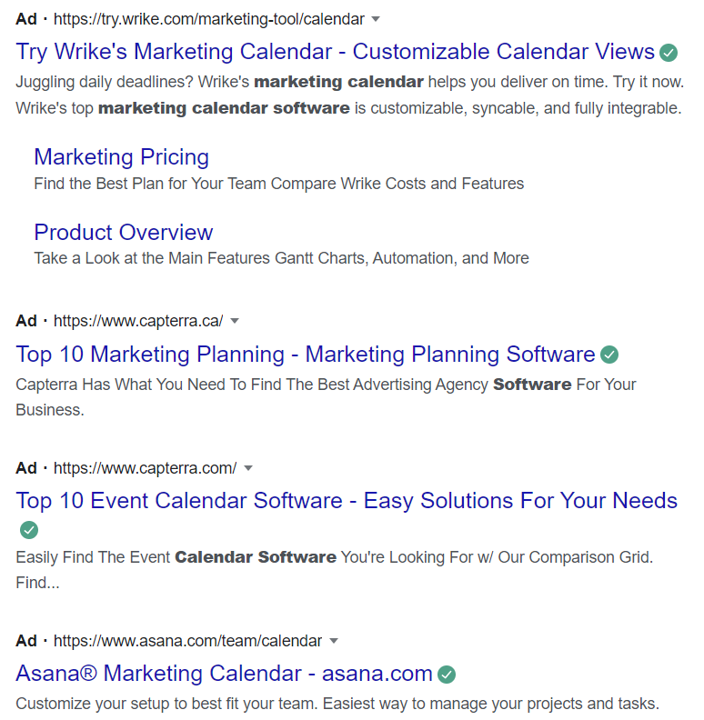
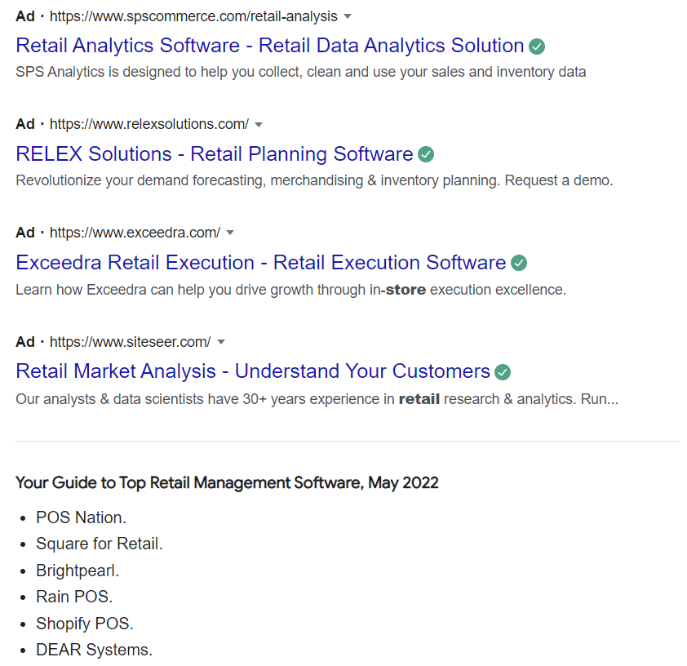
lead generation (outbound) - google advertising
Google Search Advertising Current Situation
Search: Marketing Calendar Software Search: Retail Store Profiling Software
Action Steps:
Marketing Calendar - needs to show up and compete for searches
Distro - needs to show up for personas searching for other solutions

Slide 143
Action Plan & Next Steps

Slide 144
Budget
  2.5% $125K
  First 6 months (see plan)
  All foundational items
  *need unknowns answered
  10% $500K ($432K)
  12 months (see plan)
  Includes all recommended ads, association memberships, trade show sponsorships
  *need unknowns answered
Unknowns:
website technology, Hubspot account level, martech stack, execution team, other external suppliers, timing, vendor vs. fractional CMO + your marketing team as a partner.

Slide 145
Next Steps:
  Revise strategy based on feedback today
  Deliver strategy & action plan
  Deliver proposed budget, resourcing and timelines for approval
  Following approval - meet with team and get started!

